Slide 1


Behavioral modeling in social networks from micro to macro
Meng Jiang, University of Illinois at Urbana-Champaign
Peng Cui, Tsinghua University
ICDM 2015 TUTORIAL
Atlantic City, NJ

Slide 2



Thanks to
National Natural Science Foundation of China,
No. 61370022, No. 61210008, No. 61303075
International Science & Technology Cooperation Program of China,
No. 2013DFG12870
National Program on Key Basic Research Project,
No. 2011CB302206, No. 2015CB352300
NExT Research Center funded by MDA, Singapore,
WBS:R-252-300-001-490
Tsinghua-Tencent Joint Laboratory

Slide 3
introduction
Behavior Modeling in Social Networks

Slide 4
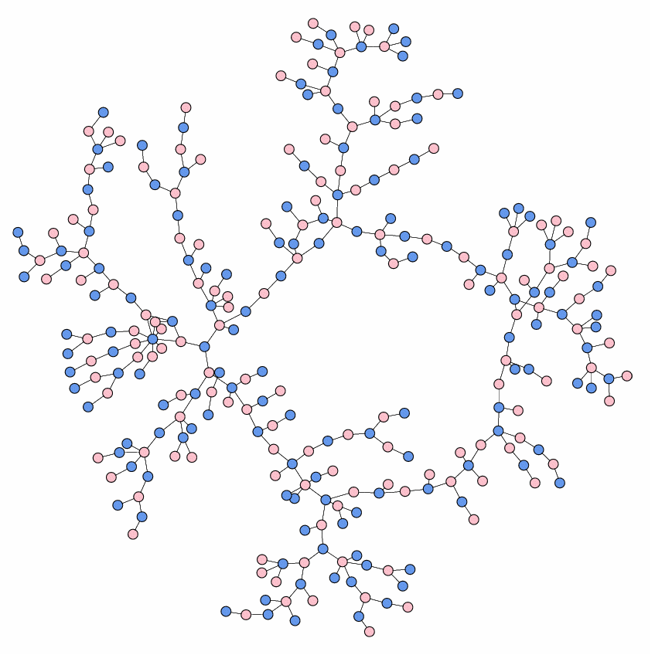

Behavior in Social Networks
MICRO
Individual
behavior
Natural
behavior
Information
cascade
MACRO
Unnatural/Suspicious
behavior

Slide 5
Introduction
Left for Dr. Peng Cui

Slide 6
Outline
Prediction for natural behavior
Modeling individual behavior (MICRO)
Modeling information cascade (MACRO)
Detection for unnatural behavior
Suspicious behavior detection

Slide 7
Questions for Modeling Individual Behavior
What is individual behavior in social networks?
Why should we study individual behavior?
What are the state-of-the-art models?
Modeling behaviors and social relations
Modeling social contexts
Modeling spatiotemporal contexts
Modeling multiple domains in social networks

Slide 8
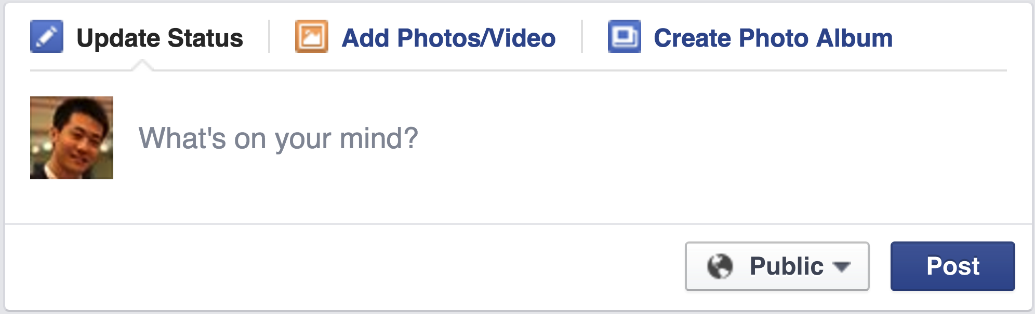
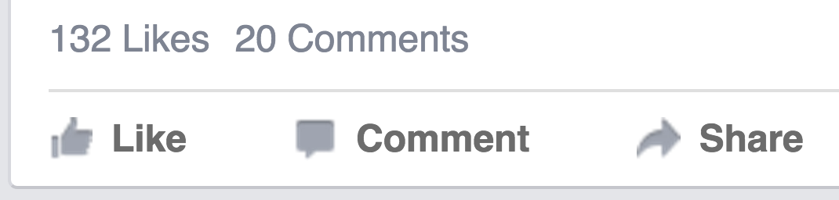
Individual Behavior: Facebook
Post: What’s on your mind?
Like, Comment, Share

Slide 9
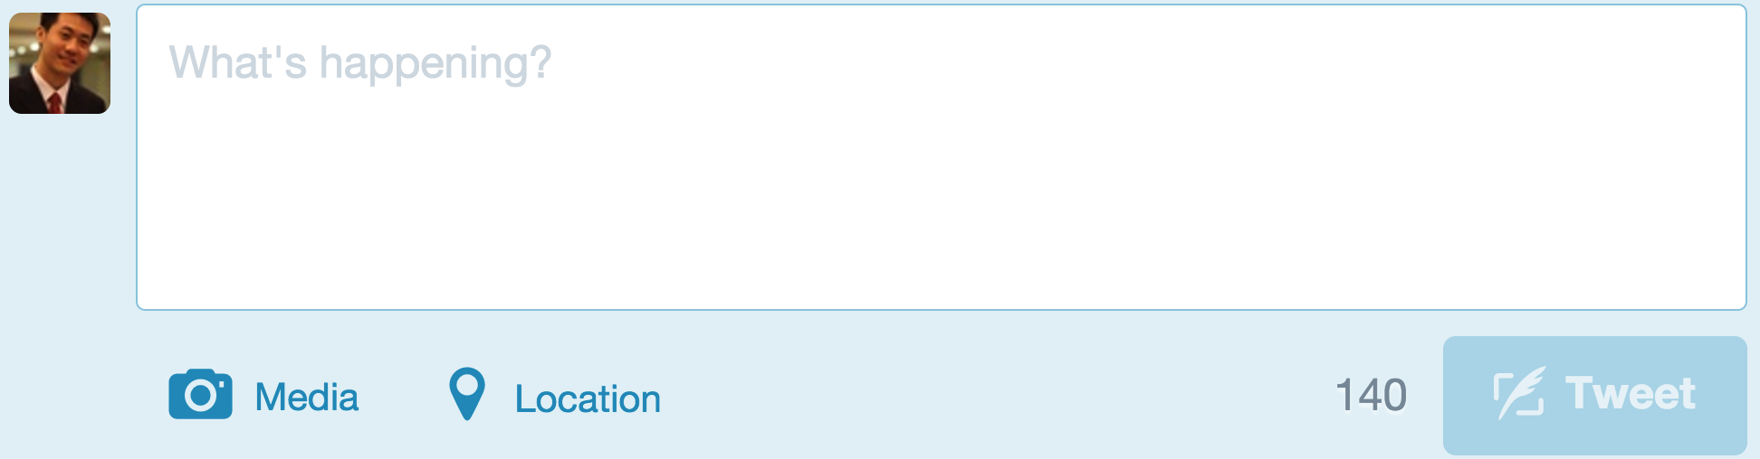
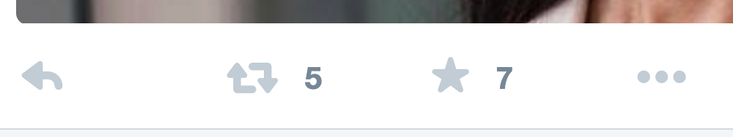
Individual Behavior: Twitter
Tweet: What’s happening?
Reply, Retweet, Favorite

Slide 10
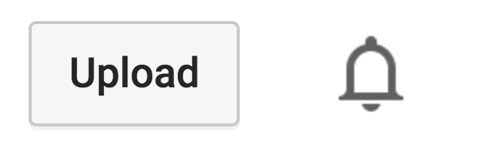
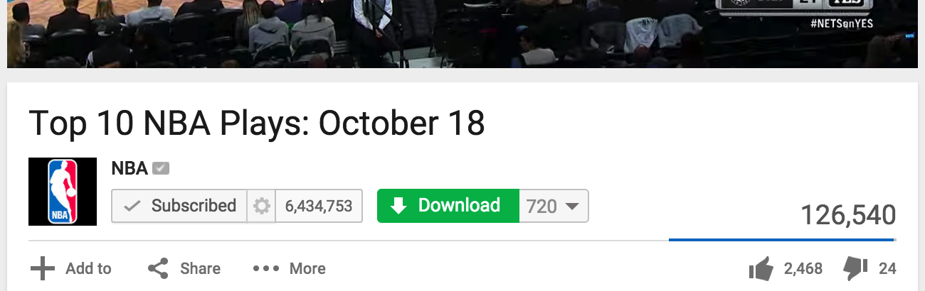
Individual Behavior: YouTube
Upload
Subscribe, Download, Add to, Share, Like, Dislike, Comment

Slide 11
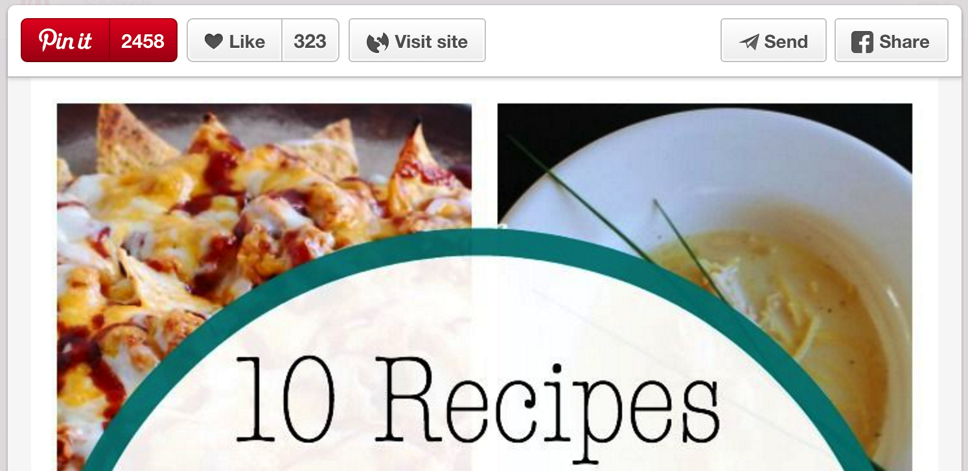
Individual Behavior: Pinterest
Pin it, Like, Visit, Send, Share

Slide 12

“Information Adoption” in Social Networks
Like
Reply
Share
Favorite
Retweet
Comment
Subscribe
Download
Add to
Send
Pin it
Visit
……

Slide 13
Modeling Information Adoption Behavior
Behavioral pattern discovery
Behavior prediction in social networks
Social recommendation

Slide 14
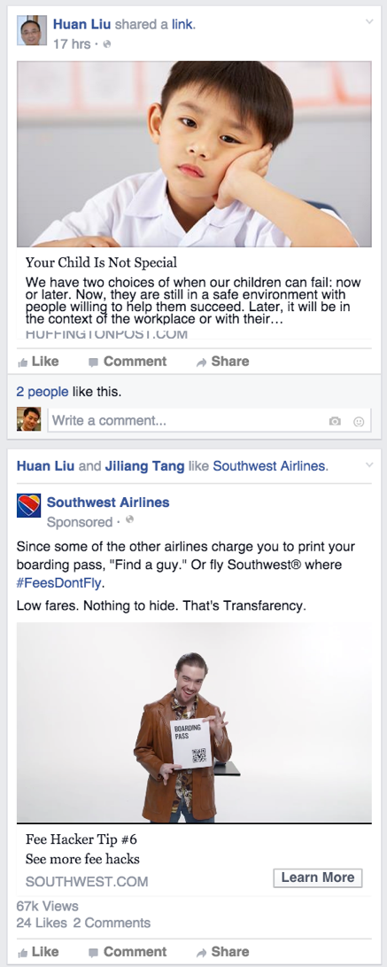
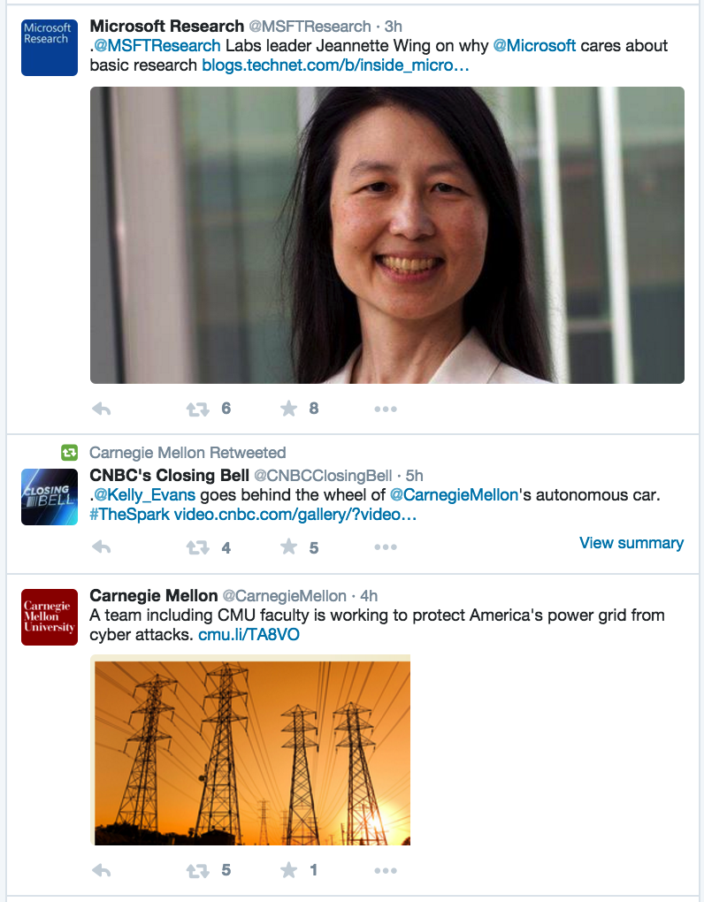
What is Social Recommendation?
Facebook
Twitter
News
Feed
Ranking

Slide 15

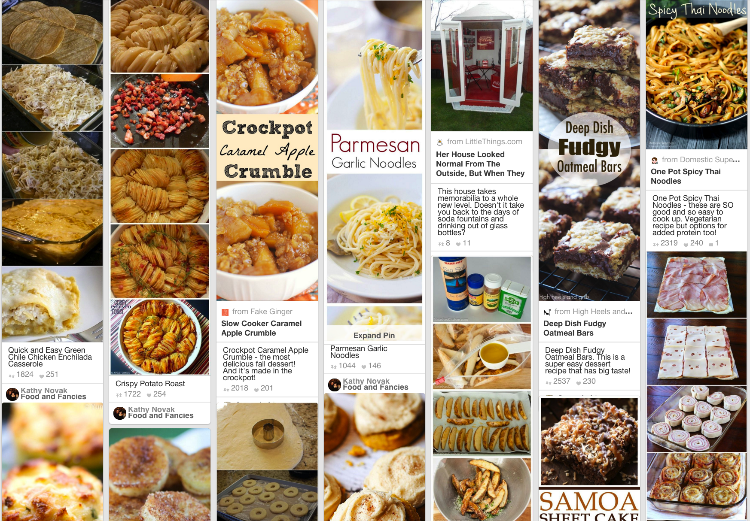
What is Social Recommendation?
YouTube
Pinterest
Social Multimedia
Recommender Systems

Slide 16
What is Social Recommendation?
“Social recommendation …, however, it has no commonly accepted definition.”
Tang et al. Social Recommendation: A Review. Social Network Analysis and Mining, 2013. Springer.

Slide 17
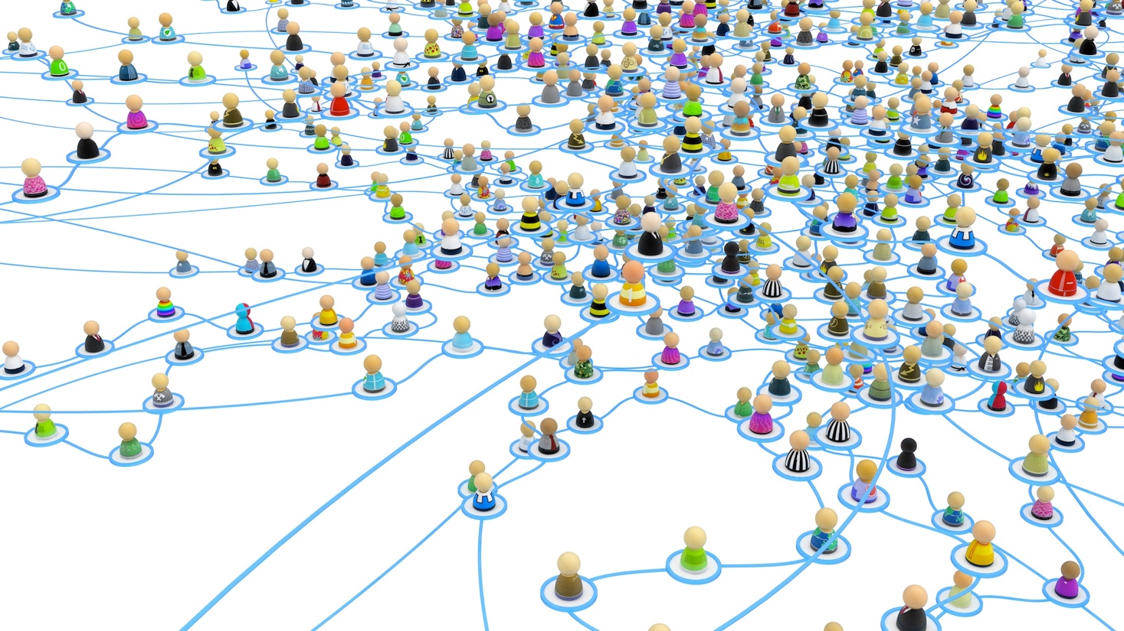
What is Social Recommendation?
“Social recommendation …, however, it has no commonly accepted definition.”
“A narrow definition of social recommendation is any recommendation with online social relations as an additional input, i.e., augmenting an existing recommendation engine with additional social signals.”
Tang et al. Social Recommendation: A Review. Social Network Analysis and Mining, 2013. Springer.

Slide 18
What is Social Recommendation?
“Social recommendation …, however, it has no commonly accepted definition.”
“A narrow definition of social recommendation is any recommendation with online social relations as an additional input, i.e., augmenting an existing recommendation engine with additional social signals.”
“Users’ preferences are likely to be similar to or influenced by their connected friends. …, social recommendation leverages user correlations implied social relations to improve the performance of recommendation.”
Tang et al. Social Recommendation: A Review. Social Network Analysis and Mining, 2013. Springer.

Slide 19
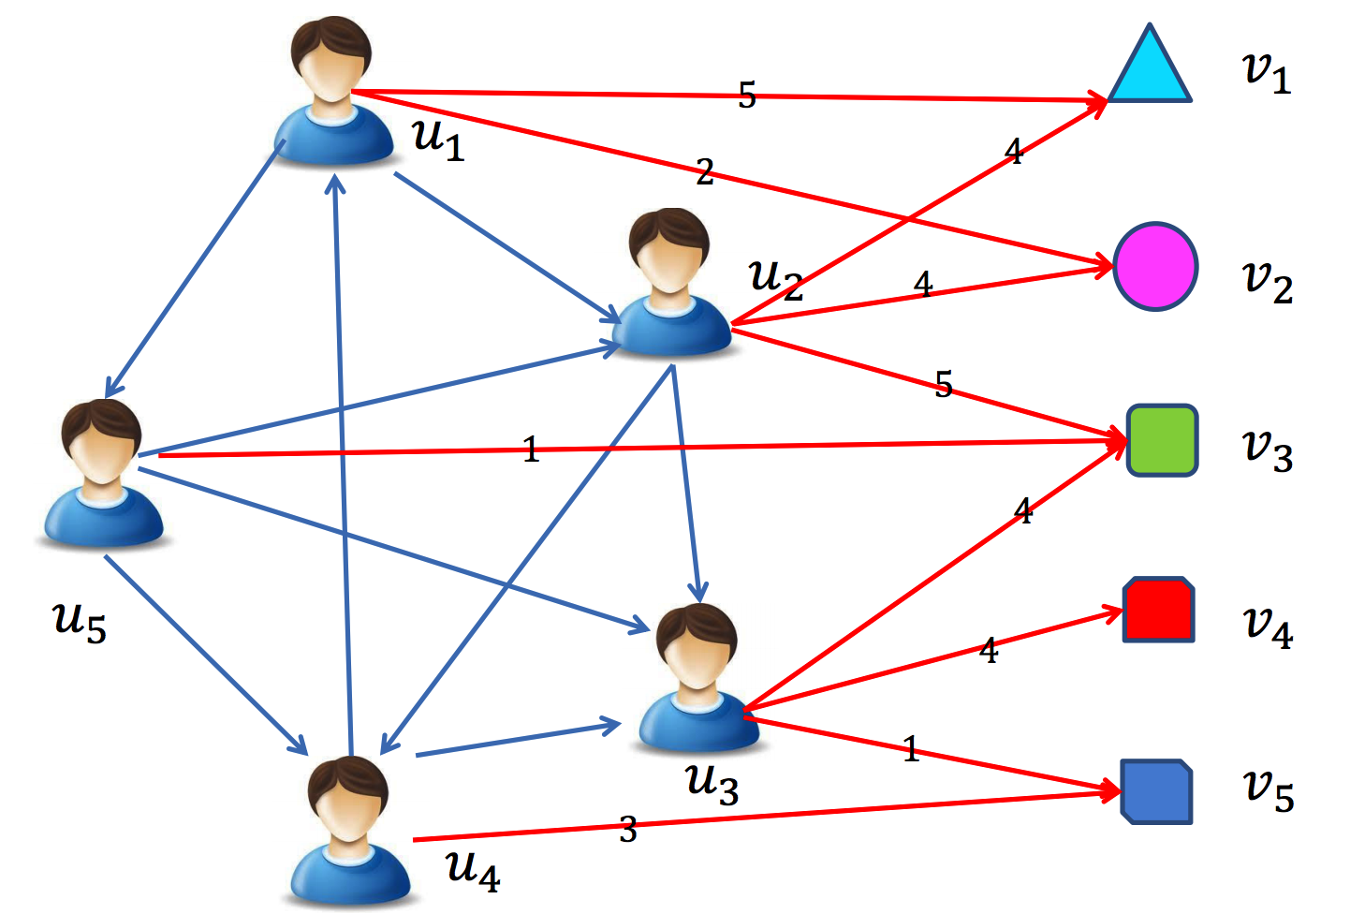
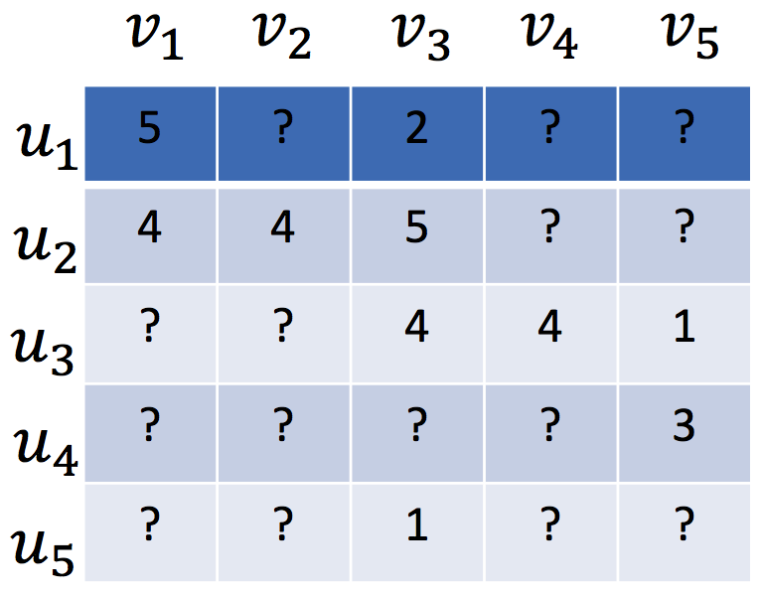
Traditional Recommender Systems
Assumed that users are independent and identically distributed
Tang et al. Social Recommendation: A Review. Social Network Analysis and Mining, 2013. Springer.

Slide 20
Traditional Recommender Systems
Content-based recommender (e.g., TFIDF)
For textual information (e.g., news, documents)
Limitation: limited content analysis, over-specialization
Tang et al. Social Recommendation: A Review. Social Network Analysis and Mining, 2013. Springer.

Slide 21
Traditional Recommender Systems
Content-based recommender (e.g., TFIDF)
For textual information (e.g., news, documents)
Limitation: limited content analysis, over-specialization
Collaborative filtering based recommender
Memory-based CF (e.g., PCC, similarity)
Model-based CF (e.g., factorization based)
Limitation: data sparsity, cold-start problem
Hybrid recommender system
Tang et al. Social Recommendation: A Review. Social Network Analysis and Mining, 2013. Springer.

Slide 22
Matrix Factorization based CF (MF)
Low-rank MF on the user-item rating matrix R
User preference vector U
Item characteristic vector V
R
U
V^{T}
Koren. Factorizatoin Meets the Neighborhood: A Multifaceted Collaborative Filtering Model. KDD, 2008.

Slide 23
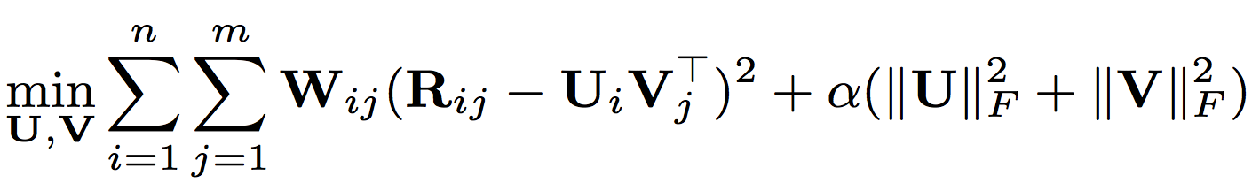
Matrix Factorization based CF (MF)
Low-rank MF on the user-item rating matrix R
User preference vector U
Item characteristic vector V
Observed weight matrix W
avoid over-fitting,
controlled by the parameter
Koren. Factorizatoin Meets the Neighborhood: A Multifaceted Collaborative Filtering Model. KDD, 2008.

Slide 24
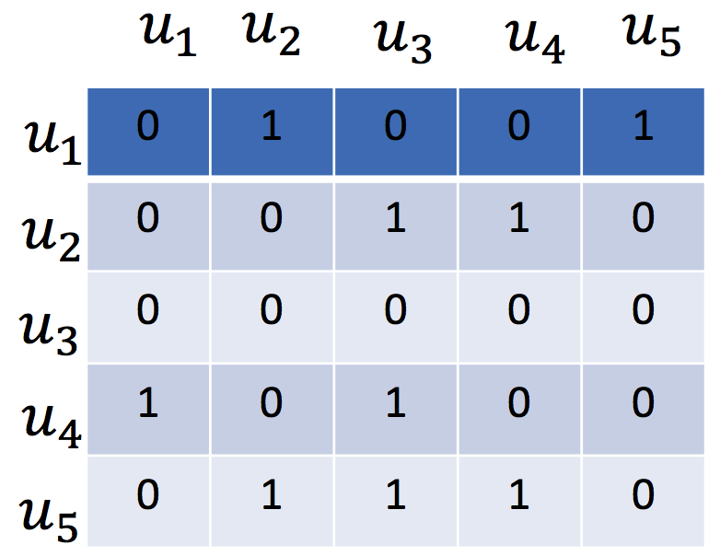
Social Recommendation
Social relations
Tang et al. Social Recommendation: A Review. Social Network Analysis and Mining, 2013. Springer.

Slide 25
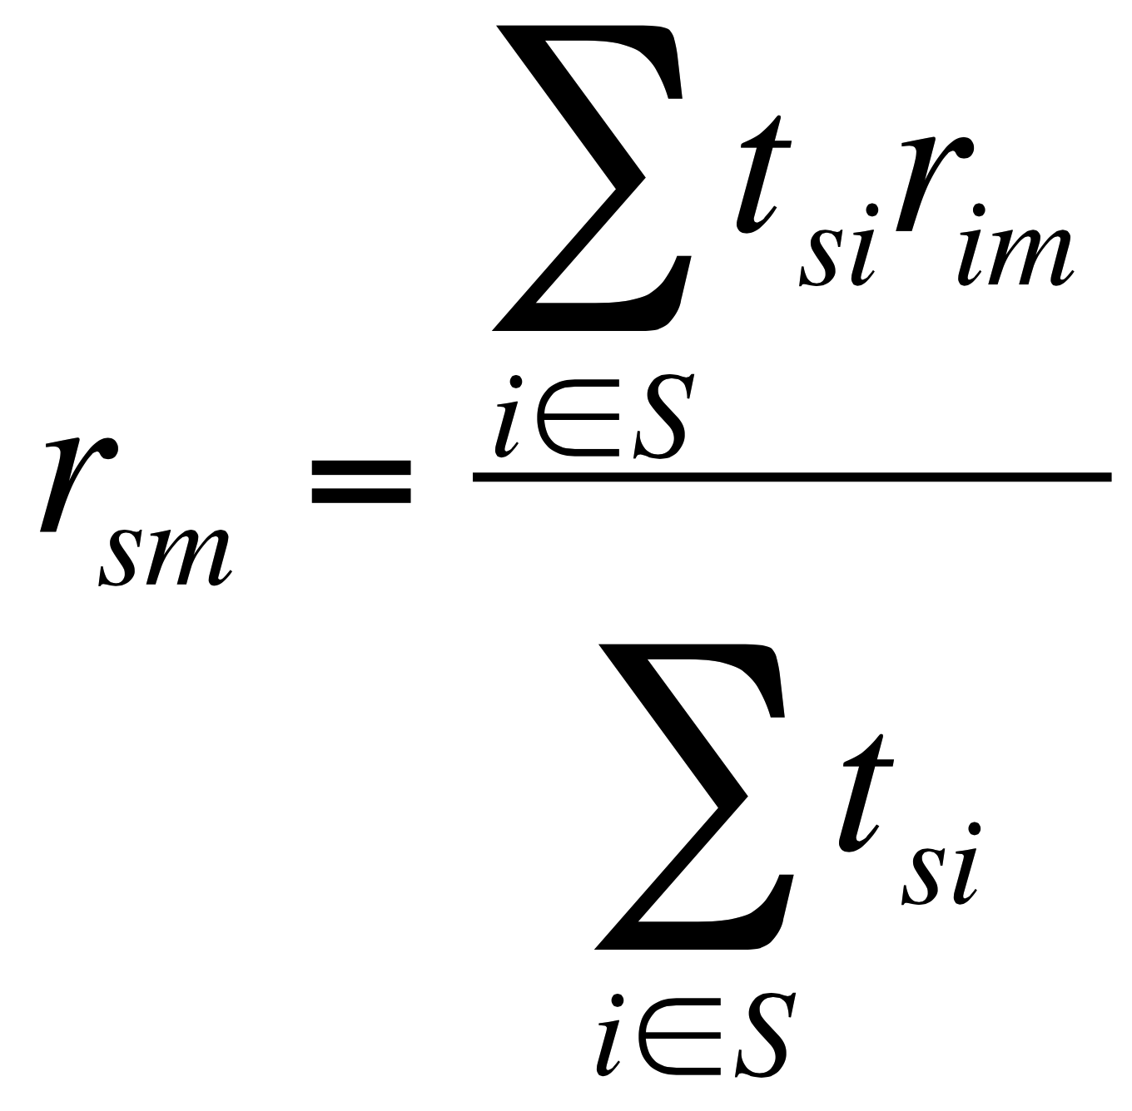
Memory based Social Recommender
TidalTrust
rating
(user i, item m)
rating
(user s, item m)
trust from social relation
(user s, user i)
Golbeck. Personalizing applications through integration of inferred trust values in semantic web-based social networks. Semantic Network Analysis Workshop, 2005.

Slide 26
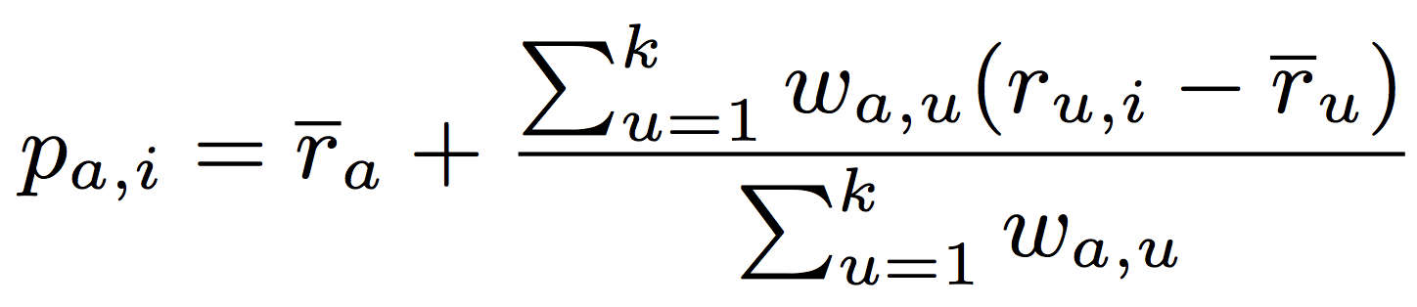
Memory based Social Recommender
MoleTrust
rating
(user u, item i)
average rating
(user u)
average rating
(user a)
predicted rating
(user a, item i)
trust from social relation
(user a, user u)
Massa et al. Trust-aware recommender systems. RecSys, 2007.

Slide 27
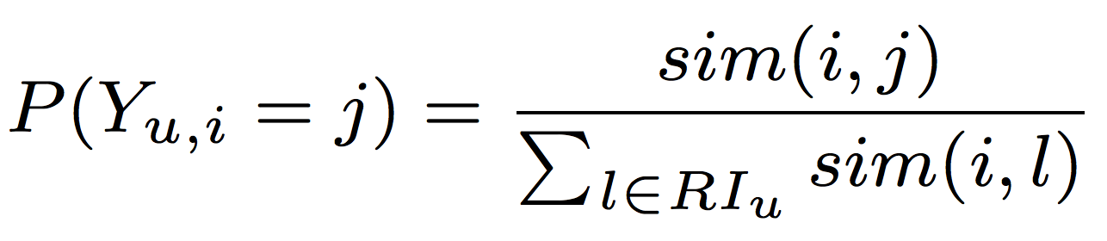
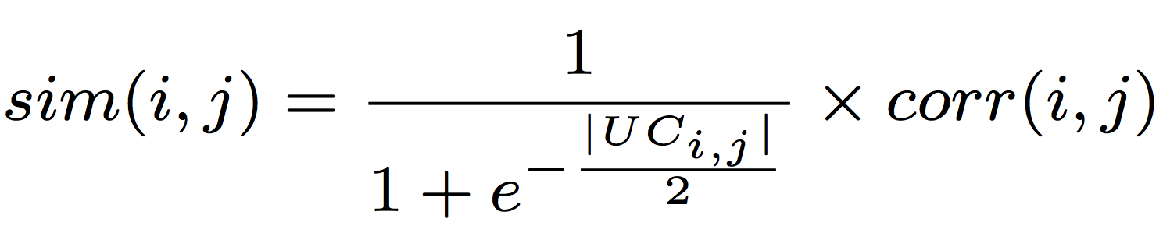
Memory based Social Recommender
similarity measure
(item i, item j)
TrustWalker
probability of
user u’s random walk
from item i to item j
Pearson correlation
of (item i, item j)
common user set
of (item i, item j)
Jamali et al. TrustWalker: A Random Walk Model for Combining Trust-based and Item-based Recommendation. KDD, 2009.

Slide 28
Model based Social Recommender
Optimization methods such as gradient based methods can be applied to find a well-worked optimal solution.
MF has a nice probabilistic interpretation with Gaussian noise.
MF is very flexible and allows us to include prior knowledge.
Social Recommendation CF
= Basic CF + Social Information Model
Tang et al. Social Recommendation: A Review. Social Network Analysis and Mining, 2013. Springer.

Slide 29
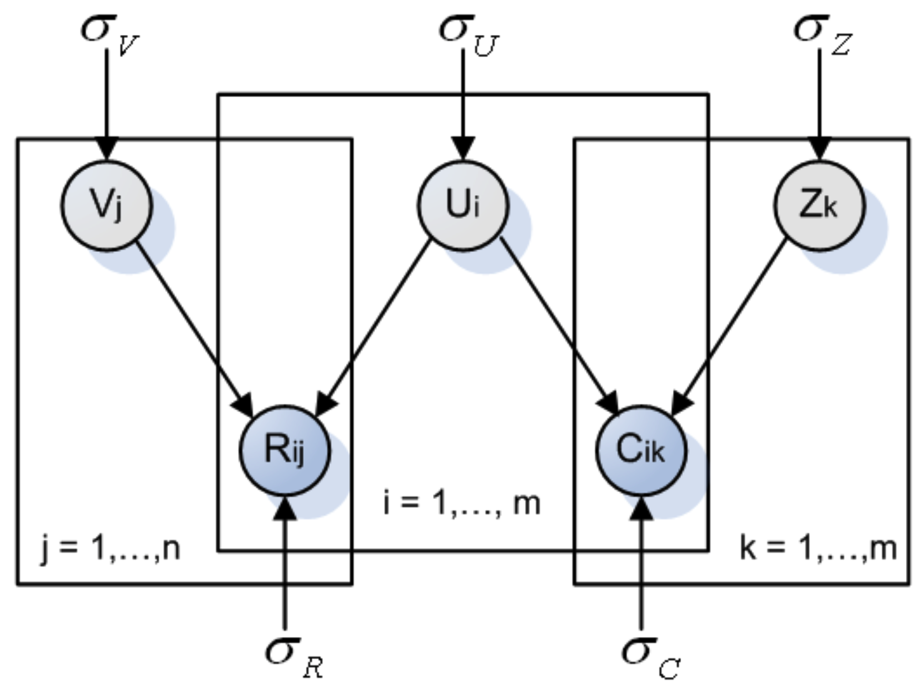
Model based Social Recommender
factor vector
SoRec
item vector
user vector
R: user-item
rating matrix
C: user-user
social matrix
Ma et al. Social Recommendation Using Probabilistic Matrix Factorization. CIKM, 2008. Improving Recommender Systems by Incorporating Social Contextual Information. TIS, 2011.

Slide 30
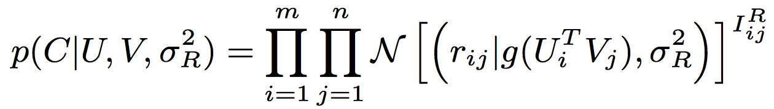
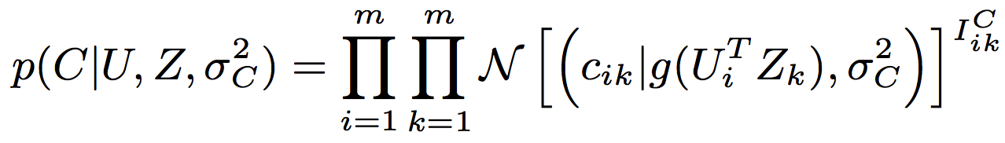
Model based Social Recommender
SoRec
R
Gaussian distribution
Logistic function
Observed
Ma et al. Social Recommendation Using Probabilistic Matrix Factorization. CIKM, 2008. Improving Recommender Systems by Incorporating Social Contextual Information. TIS, 2011.

Slide 31
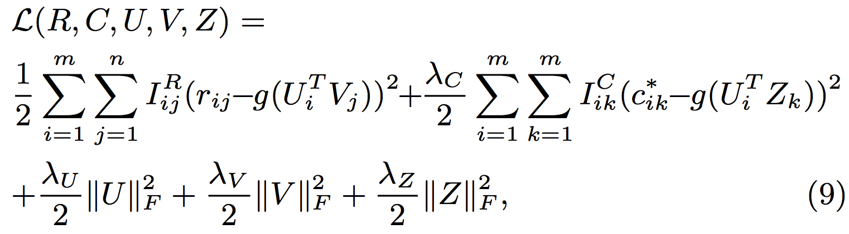
Model based Social Recommender
SoRec
behavioral term
social term
regularization terms
Ma et al. Social Recommendation Using Probabilistic Matrix Factorization. CIKM, 2008. Improving Recommender Systems by Incorporating Social Contextual Information. TIS, 2011.

Slide 32
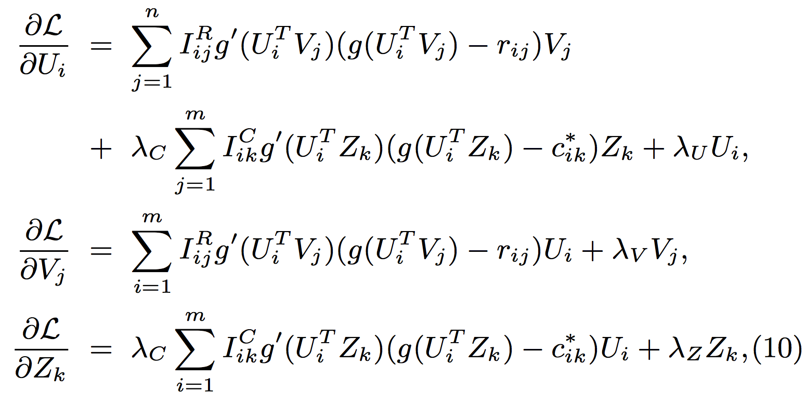
Model based Social Recommender
SoRec
Gradient Descent Methods
deviate of
Logistic
function
Ma et al. Social Recommendation Using Probabilistic Matrix Factorization. CIKM, 2008. Improving Recommender Systems by Incorporating Social Contextual Information. TIS, 2011.

Slide 33
Model based Social Recommender
SoRec
Ma et al. Social Recommendation Using Probabilistic Matrix Factorization. CIKM, 2008. Improving Recommender Systems by Incorporating Social Contextual Information. TIS, 2011.

Slide 34
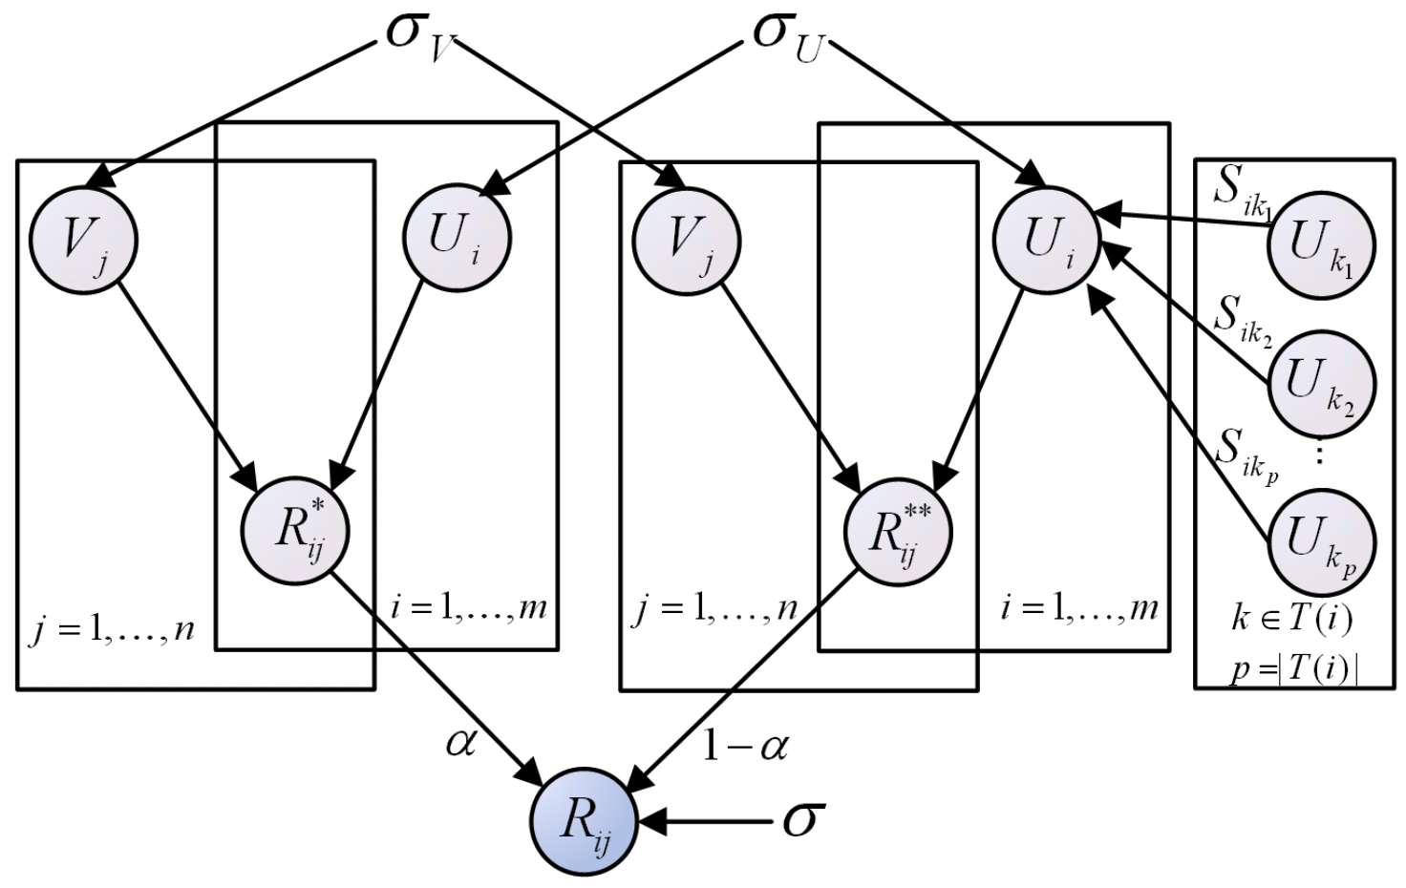
Model based Social Recommender
Replacing social with trust
“Social Trust” Ensemble for Epinion data
From user-item
matrix
From trusted friends
Operation “plus”
Ma et al. Learning to Recommend with Social Trust Ensemble. SIGIR, 2009. Learning to Recommend with Explicit and Implicit Social Relations. TIST, 2011.

Slide 35
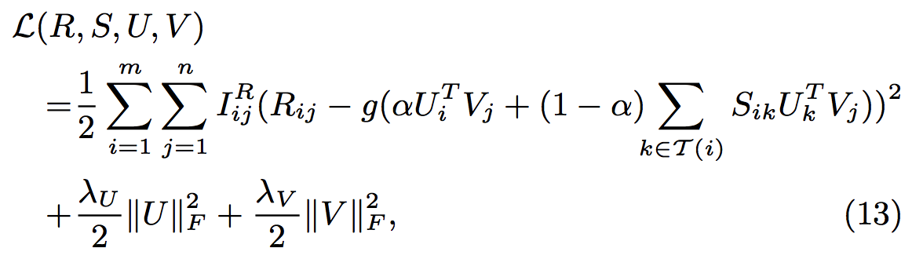
Model based Social Recommender
“Social Trust” Ensemble
From user-item
matrix
From trusted friends
Ma et al. Learning to Recommend with Social Trust Ensemble. SIGIR, 2009. Learning to Recommend with Explicit and Implicit Social Relations. TIST, 2011.

Slide 36
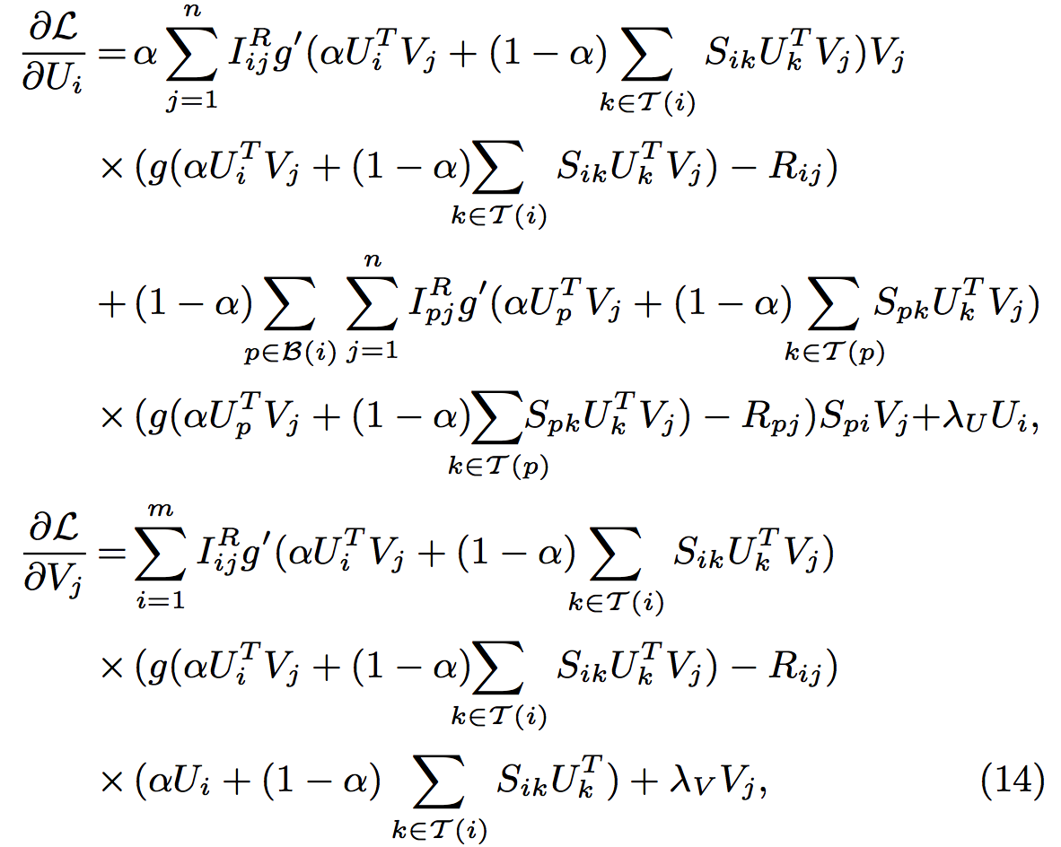
Model based Social Recommender
“Social Trust” Ensemble
Gradient
Descent
Methods
Ma et al. Learning to Recommend with Social Trust Ensemble. SIGIR, 2009. Learning to Recommend with Explicit and Implicit Social Relations. TIST, 2011.

Slide 37
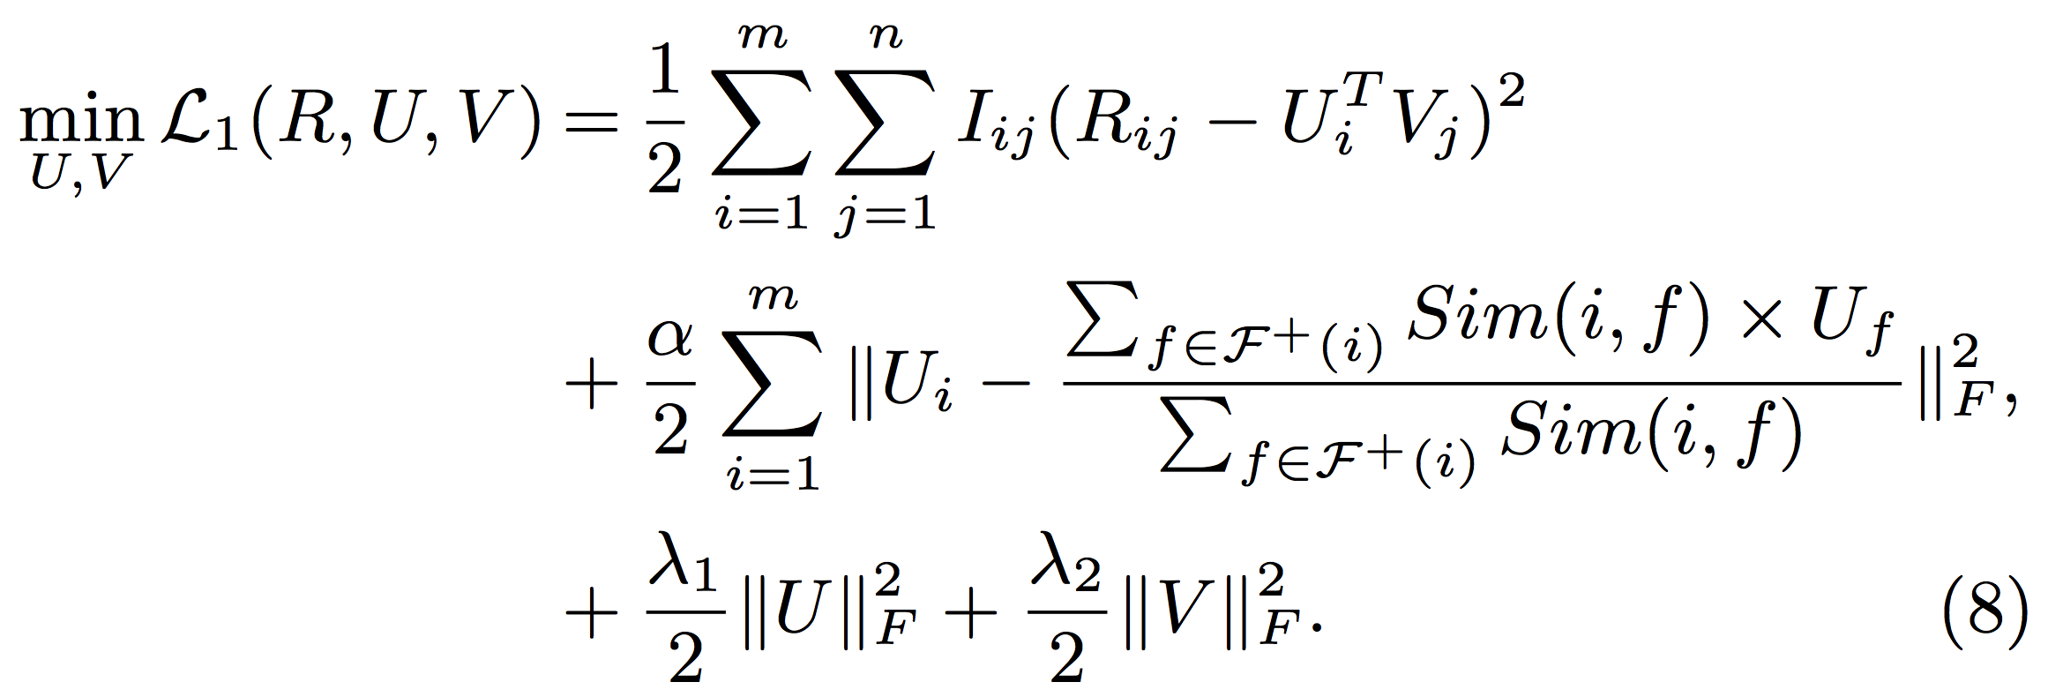
Model based Social Recommender
SoReg
Average-based regularization:
Regularize with the average of friends’ tastes
Information loss: Friends may have diverse tastes!!!
Ma et al. Recommender Systems with Social Regularization. WSDM, 2011.

Slide 38
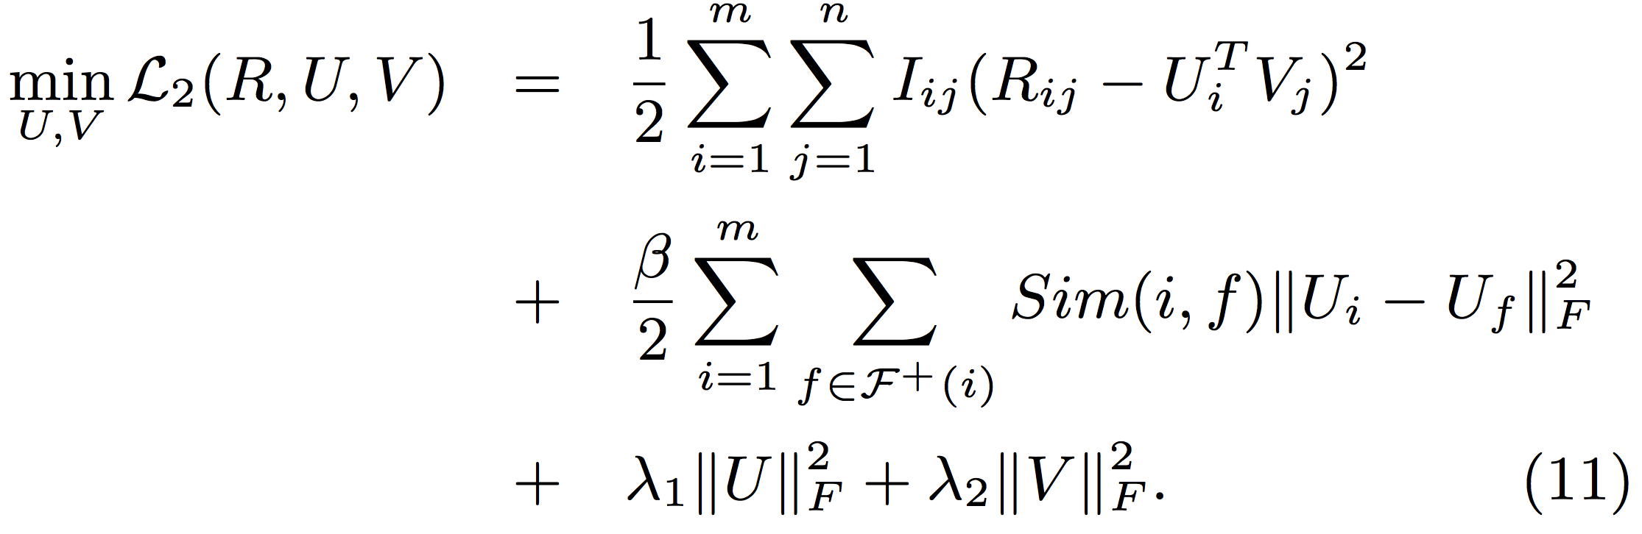
Model based Social Recommender
SoReg
Individual-based regularization:
Regularize with friends individually
Ma et al. Recommender Systems with Social Regularization. WSDM, 2011.

Slide 39
Social Recommenders Before 2012
 | Behavior | Social | Trust
SoRec [CIKM’08, TIS’11] | √ | √
“Social Trust” Ensemble [SIGIR’09, TIST’11] | √ |  | √
SoReg [WSDM’11] | √ | √
Social Contextual Information
Jiang et al. Social Contextual Recommendation. CIKM, 2012. Social Recommendation with Contextual Information. TKDE, 2014.

Slide 40
Social Contextual Information
Twitter
social relation
= social
Bob
Amy
Tom
interaction
frequency ≈ trust
Nick
retweeting/
rating = behavior
Additional
signals
item content
Post 1
Post 3
Post 2
Jiang et al. Social Contextual Recommendation. CIKM, 2012. Social Recommendation with Contextual Information. TKDE, 2014.

Slide 41


Behavioral Mechanism?
(0) follow
Jiang et al. Social Contextual Recommendation. CIKM, 2012. Social Recommendation with Contextual Information. TKDE, 2014.

Slide 42
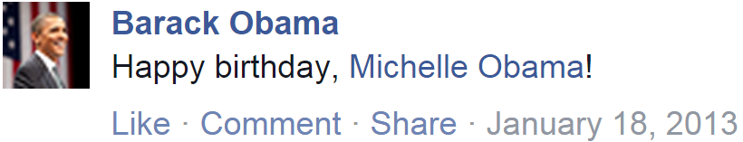
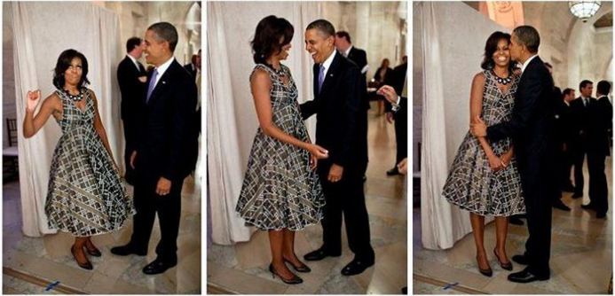
Information Adoption Behavior Intention
(0) follow
(1) post
(2) receive & read
Jiang et al. Social Contextual Recommendation. CIKM, 2012. Social Recommendation with Contextual Information. TKDE, 2014.

Slide 43
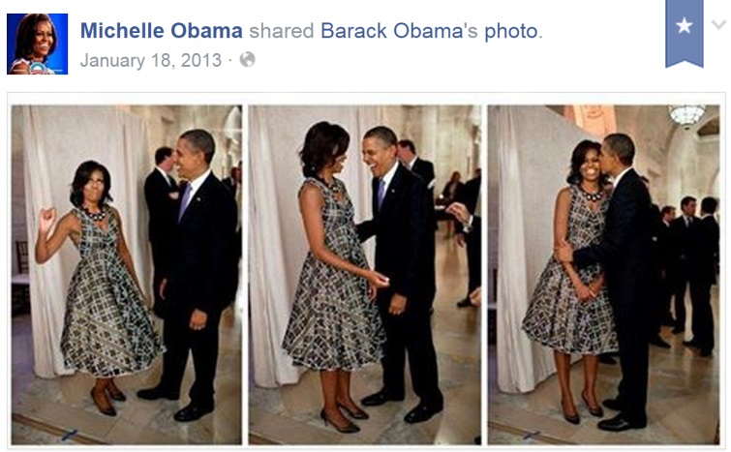
Information Adoption Behavior Intention
(0) follow
(1) post
(2) receive & read
(3) adopt?
Jiang et al. Social Contextual Recommendation. CIKM, 2012. Social Recommendation with Contextual Information. TKDE, 2014.

Slide 44
Information Adoption Behavior Intention
Birthday –
NOT politic issues!
(0) follow
(1) post
(2) receive & read
(3) adopt?
Jiang et al. Social Contextual Recommendation. CIKM, 2012. Social Recommendation with Contextual Information. TKDE, 2014.

Slide 45
Information Adoption Behavior Intention
Birthday –
NOT politic issues!
From my husband –
NOT fans on Twitter!
(0) follow
(1) post
(2) receive & read
(3) adopt?
Jiang et al. Social Contextual Recommendation. CIKM, 2012. Social Recommendation with Contextual Information. TKDE, 2014.

Slide 46
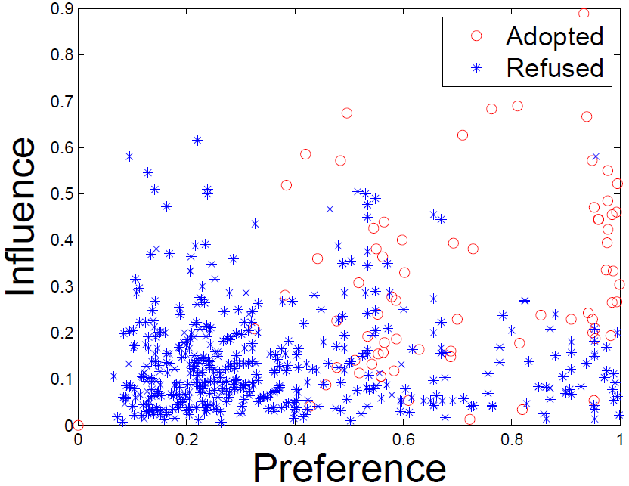
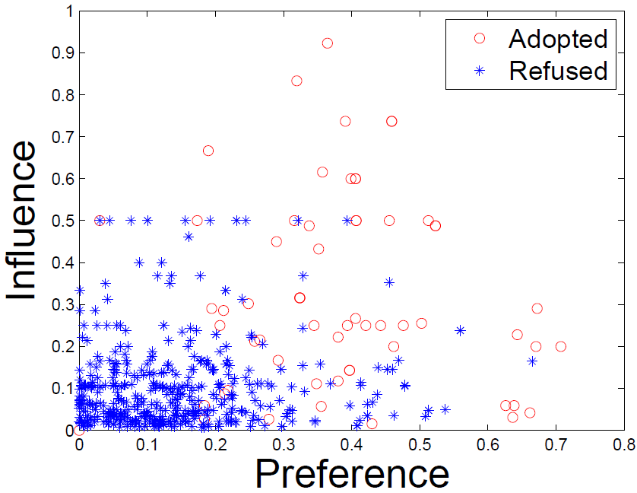
Social Contextual Factors
Individual Preference & Interpersonal Influence
China’s Facebook:
Renren
China’s Twitter:
Tencent Weibo
Jiang et al. Social Contextual Recommendation. CIKM, 2012. Social Recommendation with Contextual Information. TKDE, 2014.

Slide 47
From Information to Factors
Content:
item content
Behavior:
individual preference on the given item
user-item interaction
Social:
social relation
interpersonal influence from the sender
Trust/interaction:
user-user interaction
Jiang et al. Social Contextual Recommendation. CIKM, 2012. Social Recommendation with Contextual Information. TKDE, 2014.

Slide 48
From Information to Factors
Content:
item content
item latent feature V
Behavior:
individual preference on the given item
user-item interaction
user latent feature U
Social:
social relation
interpersonal influence from the sender
Trust/interaction:
user-user interaction
Jiang et al. Social Contextual Recommendation. CIKM, 2012. Social Recommendation with Contextual Information. TKDE, 2014.

Slide 49
From Information to Factors
Content:
item content
item latent feature V
Behavior:
individual preference on the given item
user-item interaction
user latent feature U
Social:
social relation
item sender G
interpersonal influence from the sender
Trust/interaction:
user-user interaction
user-user influence S
Jiang et al. Social Contextual Recommendation. CIKM, 2012. Social Recommendation with Contextual Information. TKDE, 2014.

Slide 50
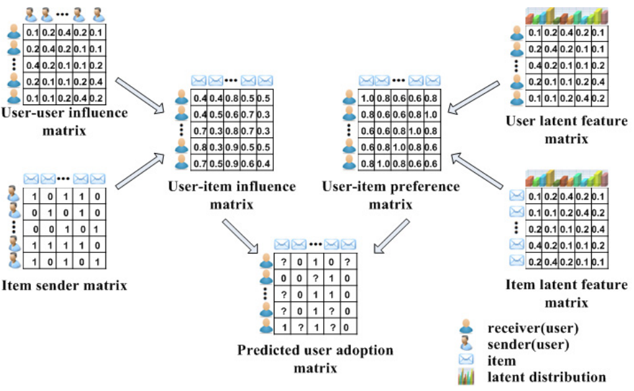
Social Contextual Recommendation
ContextMF
S
U
G
V
R
Jiang et al. Social Contextual Recommendation. CIKM, 2012. Social Recommendation with Contextual Information. TKDE, 2014.

Slide 51
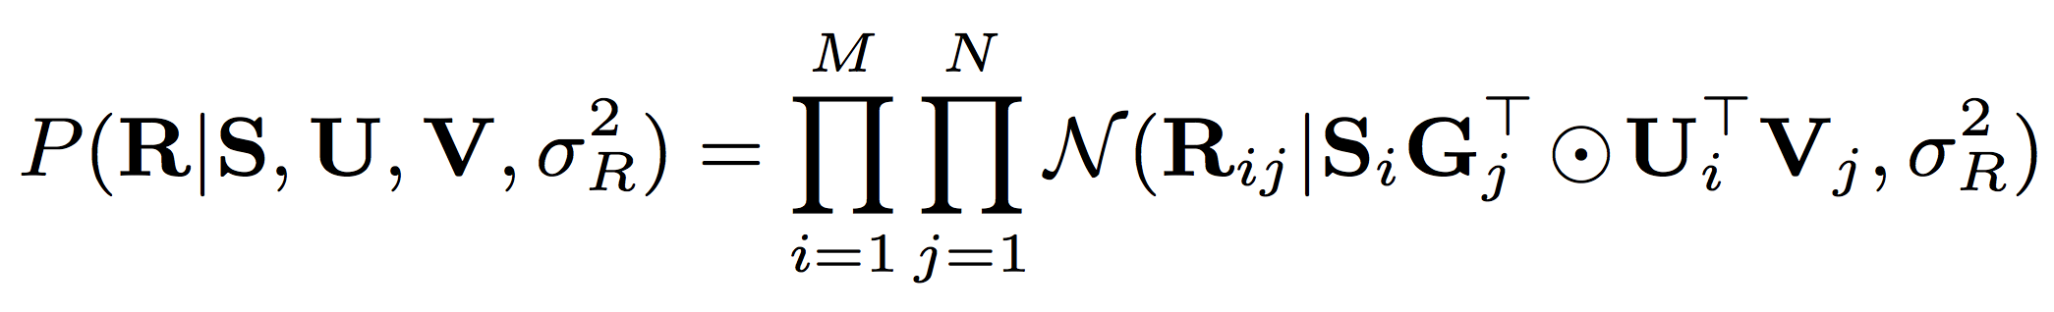
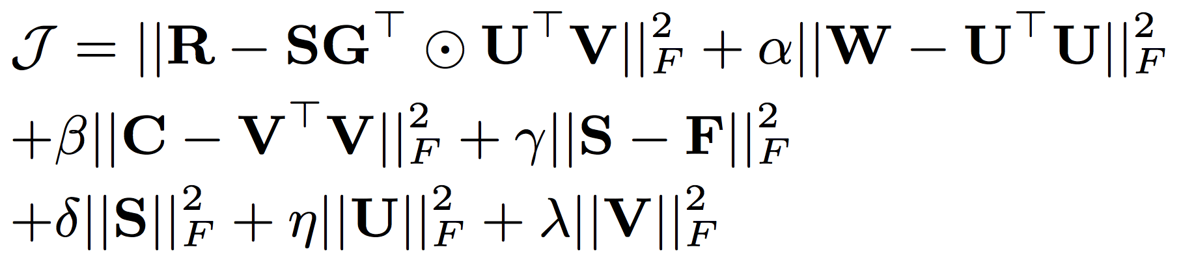
Social Contextual Recommendation
behavior
influence
preference
ContextMF
behavior
interaction frequency/trust
item content
social relation
Jiang et al. Social Contextual Recommendation. CIKM, 2012. Social Recommendation with Contextual Information. TKDE, 2014.

Slide 52
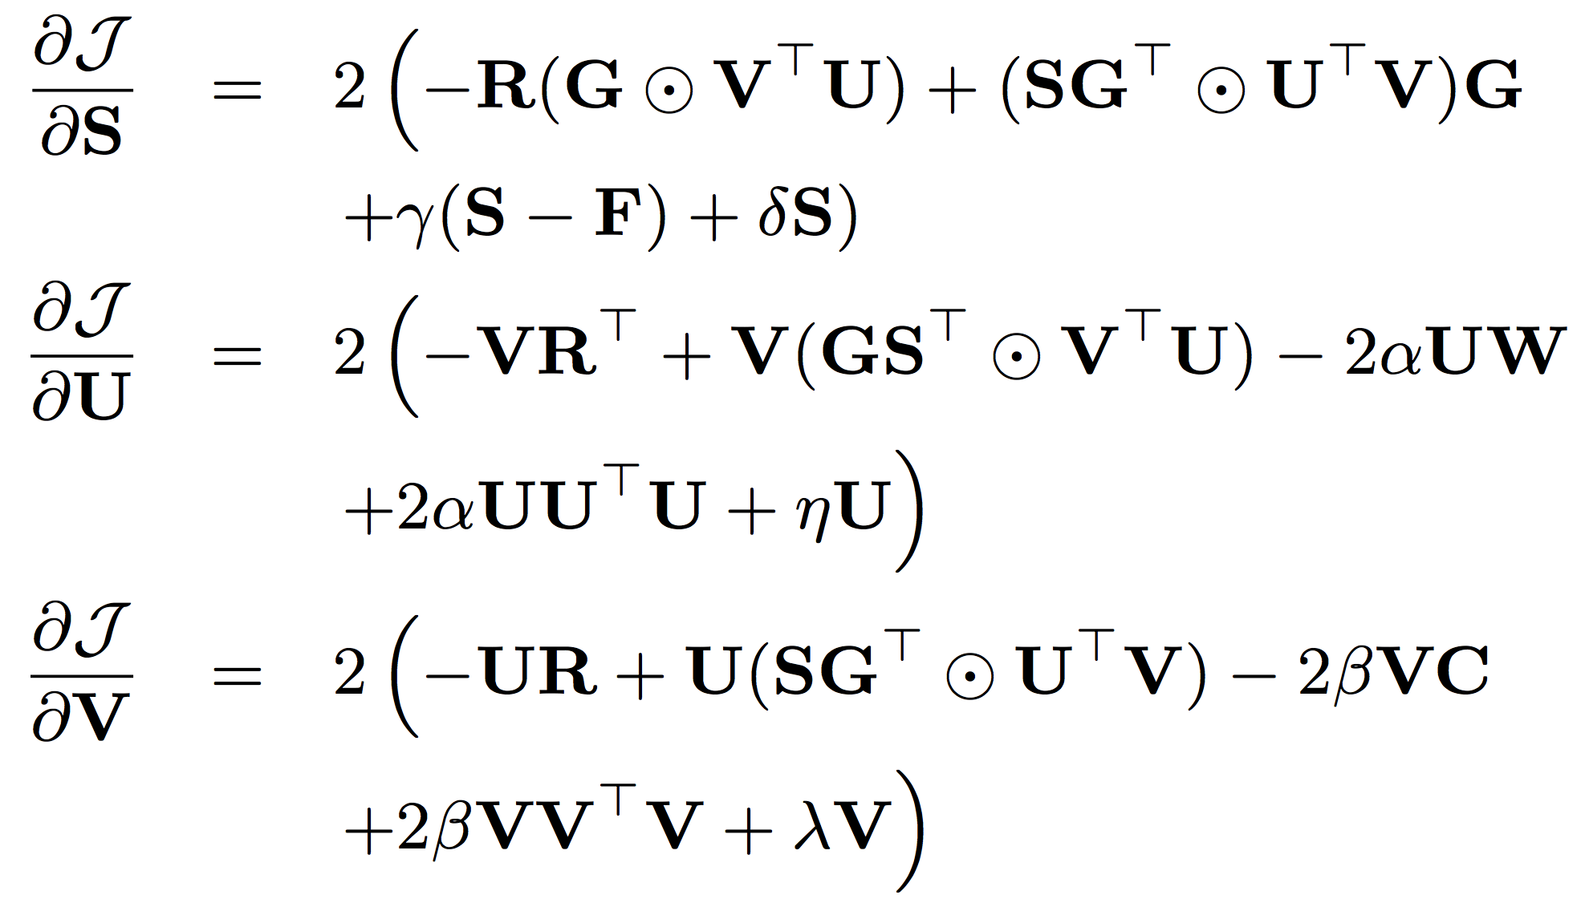
Social Contextual Recommendation
ContextMF
Gradient
Descent
Methods
Jiang et al. Social Contextual Recommendation. CIKM, 2012. Social Recommendation with Contextual Information. TKDE, 2014.

Slide 53
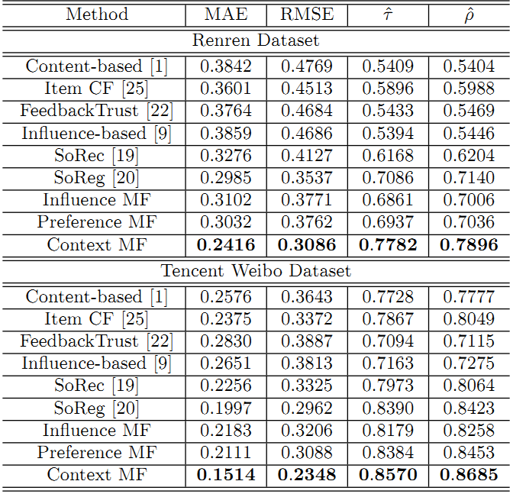
Social Contextual Recommendation
ContextMF
 | Renren | Tencent Weibo
MAE | -19.1% | -24.2%
RMSE | -12.8% | -20.7%
Kendall’s | +9.82% | +2.1%
Spearman’s | +10.6% | +3.1%
Jiang et al. Social Contextual Recommendation. CIKM, 2012. Social Recommendation with Contextual Information. TKDE, 2014.

Slide 54
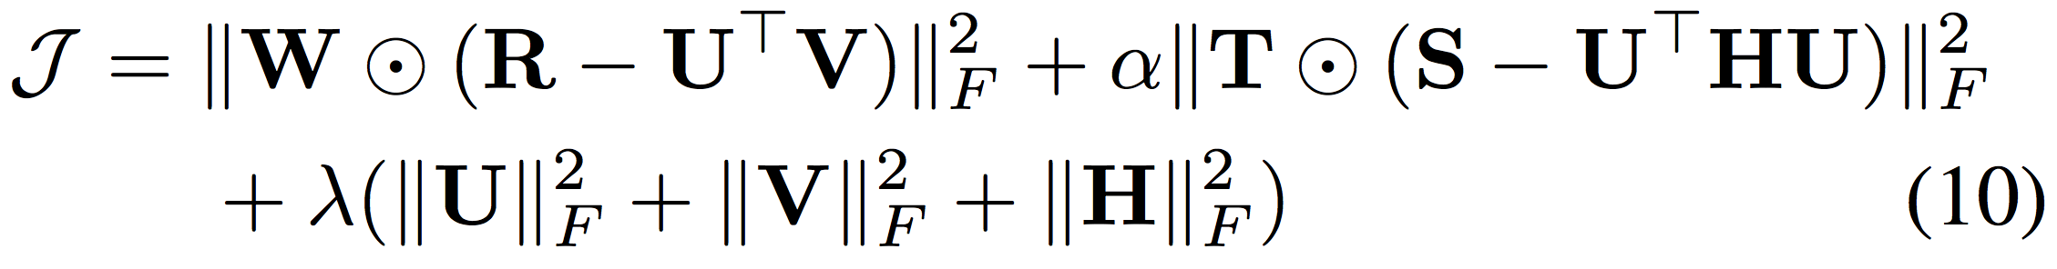
Co-Predicting Behavior and Social Relations
LOCABAL
social relation
behavior
Observed behavioral data
Observed social relation data
Tang et al. Exploiting Local and Global Social Context for Recommendation. IJCAI, 2013.

Slide 55
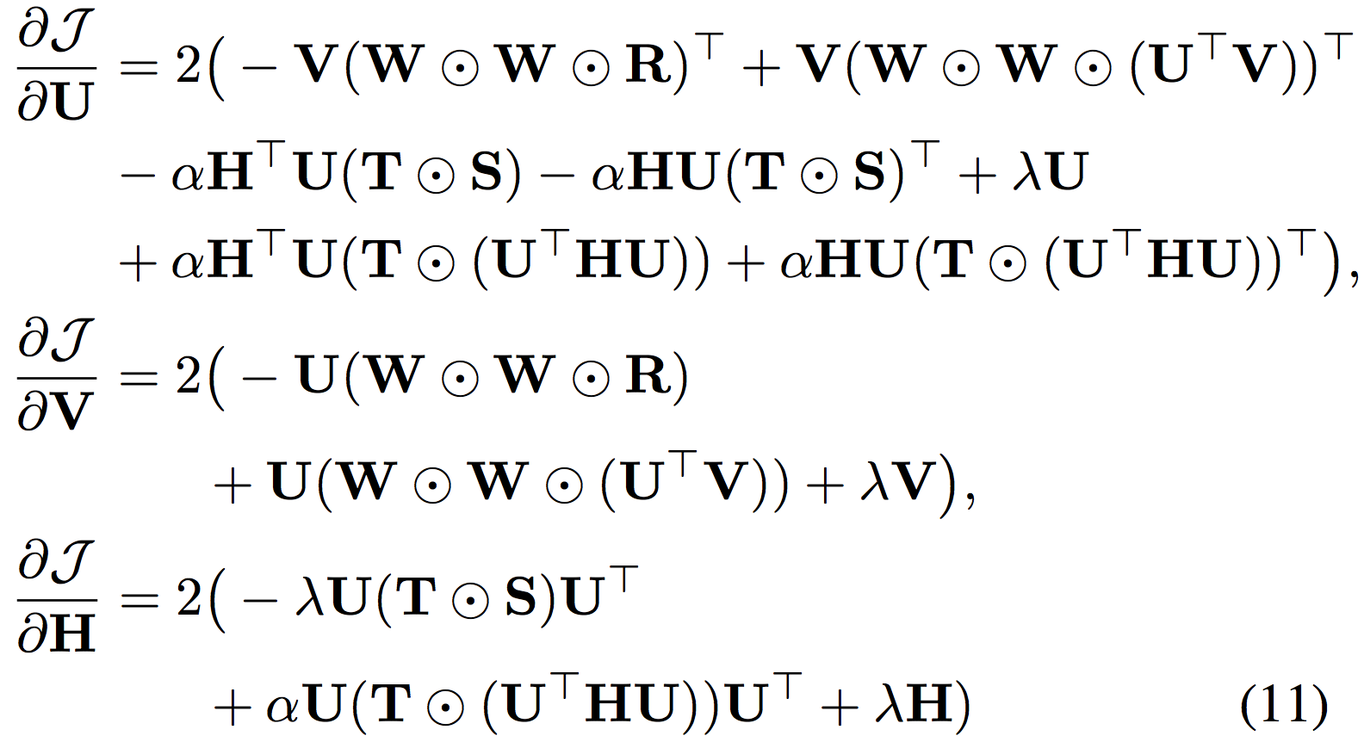
Co-Predicting Behavior and Social Relations
LOCABAL
Gradient
Descent
Methods
Tang et al. Exploiting Local and Global Social Context for Recommendation. IJCAI, 2013.

Slide 56
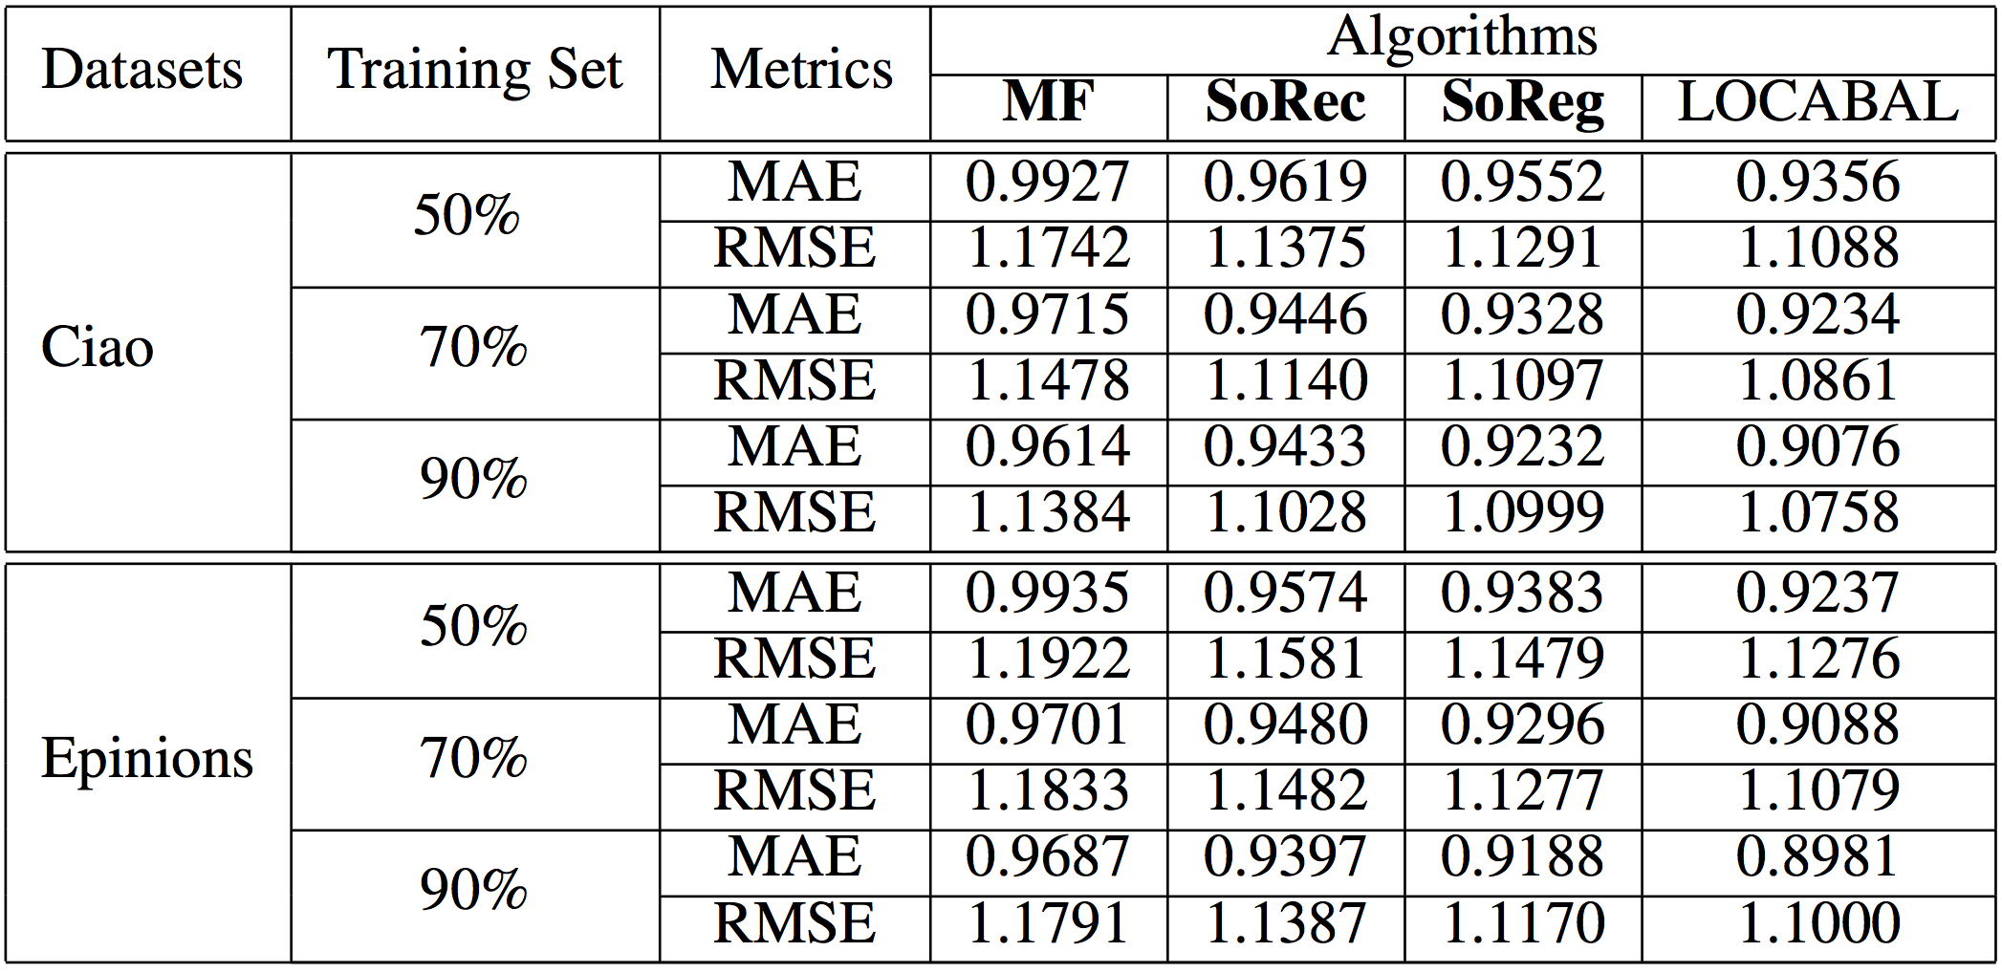
Co-Predicting Behavior and Social Relations
LOCABAL
Tang et al. Exploiting Local and Global Social Context for Recommendation. IJCAI, 2013.

Slide 57
Negative Experiences in Social Recommender
Data sparsity problem: sparse matrix.
Social relation are too noisy and may have a negative impact on recommender systems.
It is difficult for social recommenders to improve recommendation performance for cold-start users.
Different types of social relations have different effects on social recommender systems.
Tang et al. Social Recommendation: A Review. Social Network Analysis and Mining, 2013. Springer.

Slide 58

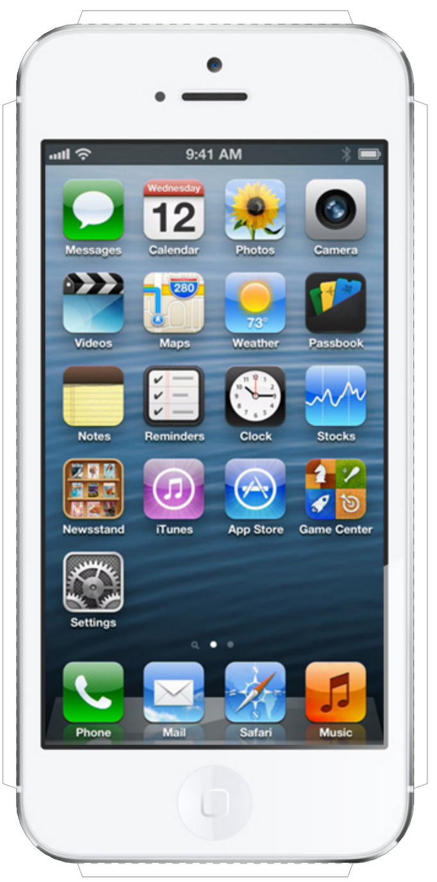
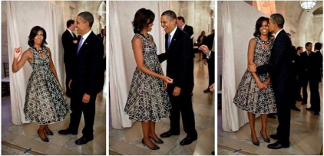

Besides Social Context: Spatial Context
Place
Device
Photo
With whom?
Who post?
Text
post
Jiang et al. Flexible Evolutionary Multi-faceted Analysis for Dynamic Behavioral Pattern Discovery. KDD, 2014.

Slide 59
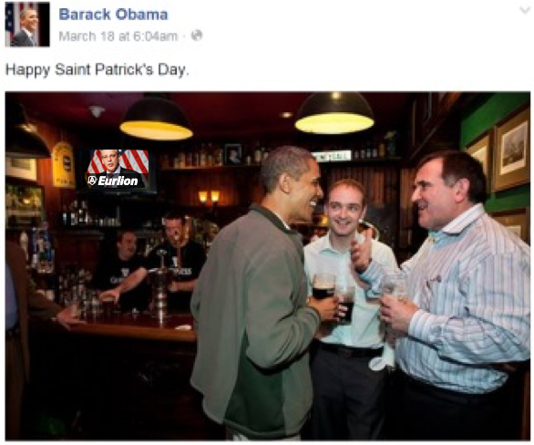
Besides Social Context: Temporal Context
Photo
Text
post
post
time
Jan. 18
Birthday party
@ White house
March 17
St. Patrick’s Day
@ Bar
Jiang et al. Flexible Evolutionary Multi-faceted Analysis for Dynamic Behavioral Pattern Discovery. KDD, 2014.

Slide 60
Modeling Spatiotemporal Contexts
Tasks
time
Who post
Text
Behavior
Place
Behavior modeling
Spatial info:
Multi-faceted
Tensor sequence
Temporal info:
Dynamic
Pattern discovery
Decomposition & Completion
Behavior prediction
≈
x
x
Jiang et al. Flexible Evolutionary Multi-faceted Analysis for Dynamic Behavioral Pattern Discovery. KDD, 2014.

Slide 61
Challenges: Sparsity and Complexity
Addressing sparsity: Flexible regularization with auxiliary data
Addressing high complexity: Incremental updates for projection matrix
Regularization:
Social context
user
item
…
user
item
time
t₃
t₂
time
item
item
t₁
user
user
t₁
t₂
t₃
Jiang et al. Flexible Evolutionary Multi-faceted Analysis for Dynamic Behavioral Pattern Discovery. KDD, 2014.

Slide 62
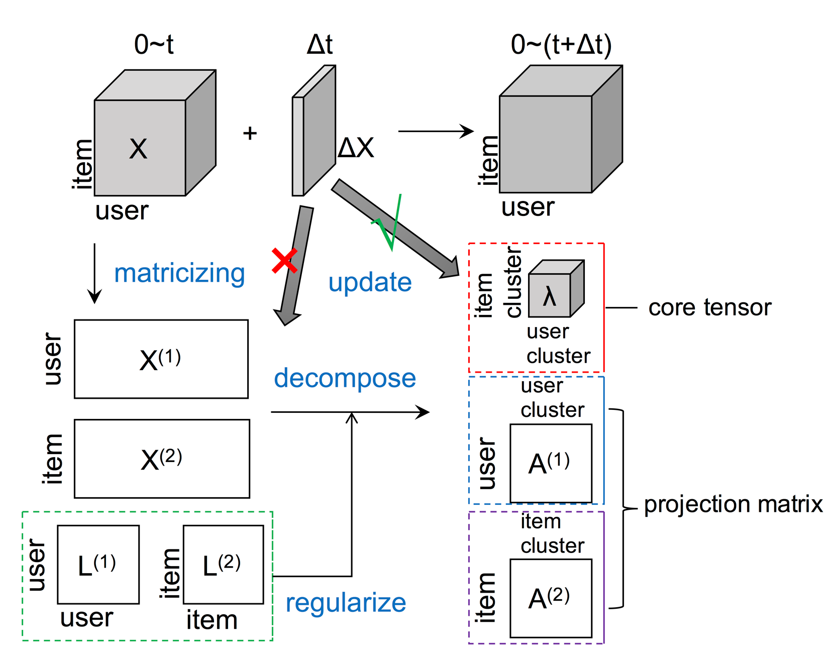
Flexible Evolutionary Multi-faceted Analysis (FEMA)
Jiang et al. Flexible Evolutionary Multi-faceted Analysis for Dynamic Behavioral Pattern Discovery. KDD, 2014.

Slide 63
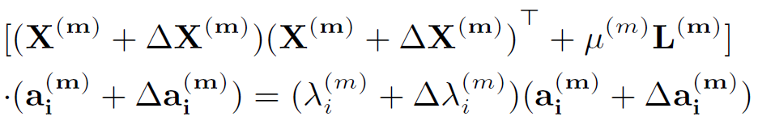
Tensor Perturbation Theory
Jiang et al. Flexible Evolutionary Multi-faceted Analysis for Dynamic Behavioral Pattern Discovery. KDD, 2014.

Slide 64
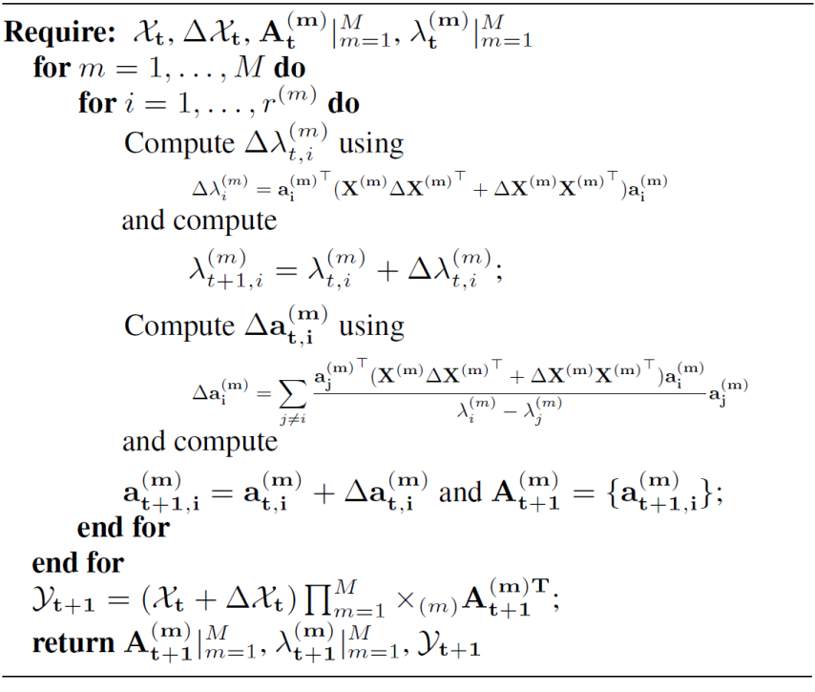
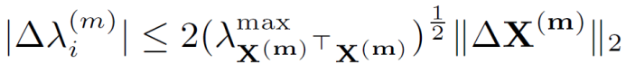

FEMA Algorithm
Approximation
Bound Guarantee
core tensor
projection matrix
Jiang et al. Flexible Evolutionary Multi-faceted Analysis for Dynamic Behavioral Pattern Discovery. KDD, 2014.

Slide 65


Individual Behavior Prediction with FEMA
 | Microsoft Academic Search |  | Tencent Weibo mentions “@”
 | MAE | RMSE | MAE | RMSE
FEMA | 0.735 | 0.944 | 0.894 | 1.312
EMA | 0.794 | 1.130 | 0.932 | 1.556
EA | 0.979 | 1.364 | 1.120 | 1.873
Precision vs Recall
X
L
X
X
Jiang et al. Flexible Evolutionary Multi-faceted Analysis for Dynamic Behavioral Pattern Discovery. KDD, 2014.

Slide 66

Individual Behavior Prediction with FEMA
Re-decomposition:
Re-compute projection matrices
Evolutionary analysis:
Use ΔX to update λ and a
Evolutionary analysis:
Use ΔX to update λ and a
Re-decomposition:
Re-compute projection matrices
Jiang et al. Flexible Evolutionary Multi-faceted Analysis for Dynamic Behavioral Pattern Discovery. KDD, 2014.

Slide 67

Behavioral Pattern: Fan@Idol#Word
Jiang et al. Flexible Evolutionary Multi-faceted Analysis for Dynamic Behavioral Pattern Discovery. KDD, 2014.

Slide 68

Behavioral Pattern: Fan@Idol#Word
Jiang et al. Flexible Evolutionary Multi-faceted Analysis for Dynamic Behavioral Pattern Discovery. KDD, 2014.

Slide 69

Demo 1: Fan@Idol#Word
http://www.meng-jiang.com/demos/fema/weibo/
Jiang et al. Flexible Evolutionary Multi-faceted Analysis for Dynamic Behavioral Pattern Discovery. KDD, 2014.

Slide 70

Demo 2: Author@Affiliation#Keyword
http://www.meng-jiang.com/demos/fema/mas/
Jiang et al. Flexible Evolutionary Multi-faceted Analysis for Dynamic Behavioral Pattern Discovery. KDD, 2014.

Slide 71

Demo 3: Author@Affiliation$Paper&Venue#Keyword
http://www.meng-jiang.com/demos/hindblp/
Jiang et al. Flexible Evolutionary Multi-faceted Analysis for Dynamic Behavioral Pattern Discovery. KDD, 2014.

Slide 72
Modeling social contexts, spatio-temporal contexts: Amazing! …however…

Slide 73
Modeling social contexts, spatio-temporal contexts: Amazing! …however…
Sparsity
in one domain…

Slide 74

Besides Contexts: Multiple Domains
Post
Jiang et al. Social Recommendation across Multiple Relational Domains. CIKM, 2012. Social Recommendation with Cross-Domain Transferable Knowledge. TKDE, 2015.

Slide 75

Besides Contexts: Multiple Domains
Image
Jiang et al. Social Recommendation across Multiple Relational Domains. CIKM, 2012. Social Recommendation with Cross-Domain Transferable Knowledge. TKDE, 2015.

Slide 76

Besides Contexts: Multiple Domains
Video
Jiang et al. Social Recommendation across Multiple Relational Domains. CIKM, 2012. Social Recommendation with Cross-Domain Transferable Knowledge. TKDE, 2015.

Slide 77

Besides Contexts: Multiple Domains
Social label
Jiang et al. Social Recommendation across Multiple Relational Domains. CIKM, 2012. Social Recommendation with Cross-Domain Transferable Knowledge. TKDE, 2015.

Slide 78

Besides Contexts: Multiple Domains
Group
Jiang et al. Social Recommendation across Multiple Relational Domains. CIKM, 2012. Social Recommendation with Cross-Domain Transferable Knowledge. TKDE, 2015.

Slide 79

Besides Contexts: Multiple Domains
Jiang et al. Social Recommendation across Multiple Relational Domains. CIKM, 2012. Social Recommendation with Cross-Domain Transferable Knowledge. TKDE, 2015.

Slide 80




Traditional Cross-Domain CF
Codebook Transfer (CBT)
m books
q movies
n users
p users
Li et al. Can Movies and Books Collaborate? Cross-Domain Collaborative Filtering for Sparsity Reduction. IJCAI, 2009.

Slide 81

Traditional Cross-Domain CF
m × l
n × k
Codebook Transfer (CBT)
m books
n users
Codebook = User Group × Item Group
k × l
Li et al. Can Movies and Books Collaborate? Cross-Domain Collaborative Filtering for Sparsity Reduction. IJCAI, 2009.

Slide 82

Traditional Cross-Domain CF
Codebook Transfer (CBT)
Codebook: k × l
q movies
q × l
p × k
p users
Li et al. Can Movies and Books Collaborate? Cross-Domain Collaborative Filtering for Sparsity Reduction. IJCAI, 2009.

Slide 83

Traditional Cross-Domain CF
Codebook Transfer (CBT)
Li et al. Can Movies and Books Collaborate? Cross-Domain Collaborative Filtering for Sparsity Reduction. IJCAI, 2009.

Slide 84

Traditional Cross-Domain CF
Coordinate System Transfer (CST)
m movies
q movies
m movies
n users
p users
n users
auxiliary data
target data
Pan et al. Transfer Learning in Collaborative Filtering for Sparsity Reduction. AAAI, 2010.

Slide 85


Traditional Cross-Domain CF
Coordinate System Transfer (CST)
auxiliary data:
target data:
Pan et al. Transfer Learning in Collaborative Filtering for Sparsity Reduction. AAAI, 2010.

Slide 86


Traditional Cross-Domain CF
FUSE
tag
tag
book
movie
user
user
Chen et al. Making Recommendation from Multiple Domains. KDD, 2013.

Slide 87

Traditional Cross-Domain CF
FUSE
Chen et al. Making Recommendation from Multiple Domains. KDD, 2013.

Slide 88

Traditional Cross-Domain CF
FUSE
Gradient
Descent
Methods
Chen et al. Making Recommendation from Multiple Domains. KDD, 2013.

Slide 89
When Social Recommendation Meets Multiple Domains
Utgt
Uaux1
Rtgt
Raux1
Uaux3
Uaux2
Raux3
Raux2
Bridge: User×Cluster
Jiang et al. Social Recommendation across Multiple Relational Domains. CIKM, 2012. Social Recommendation with Cross-Domain Transferable Knowledge. TKDE, 2015.

Slide 90
When Social Recommendation Meets Multiple Domains
Social
Bridge
Jiang et al. Social Recommendation across Multiple Relational Domains. CIKM, 2012. Social Recommendation with Cross-Domain Transferable Knowledge. TKDE, 2015.

Slide 91
When Social Recommendation Meets Multiple Domains
Rtgt
Raux1
Raux3
Raux2
Bridge: User×User
Jiang et al. Social Recommendation across Multiple Relational Domains. CIKM, 2012. Social Recommendation with Cross-Domain Transferable Knowledge. TKDE, 2015.

Slide 92

Hybrid Random Walk
Starting with a Second-Order Start-Structured Graph
Jiang et al. Social Recommendation across Multiple Relational Domains. CIKM, 2012. Social Recommendation with Cross-Domain Transferable Knowledge. TKDE, 2015.

Slide 93






Hybrid Random Walk
Updating cross-domain links
Updating within-domain links
Jiang et al. Social Recommendation across Multiple Relational Domains. CIKM, 2012. Social Recommendation with Cross-Domain Transferable Knowledge. TKDE, 2015.

Slide 94

Hybrid Random Walk
High-Order Star-Structured Graph
Jiang et al. Social Recommendation across Multiple Relational Domains. CIKM, 2012. Social Recommendation with Cross-Domain Transferable Knowledge. TKDE, 2015.

Slide 95


Hybrid Random Walk
Comparing with Random Walk with Restarts Models
Comparing with Social Recommendation Baselines
Jiang et al. Social Recommendation across Multiple Relational Domains. CIKM, 2012. Social Recommendation with Cross-Domain Transferable Knowledge. TKDE, 2015.

Slide 96

Hybrid Random Walk
Knowledge transfer from auxiliary domains improves cold-start users’ behavior prediction
Using aux. (label) data, saving 60-70% tgt. (post) data
35% user-post
0 user-label
0 user-post
100% user-label
60% user-post
0 user-label
18% user-post
100% user-label
Jiang et al. Social Recommendation across Multiple Relational Domains. CIKM, 2012. Social Recommendation with Cross-Domain Transferable Knowledge. TKDE, 2015.

Slide 97
Questions for Modeling Individual Behavior
What is individual behavior in social networks?
Why should we study individual behavior?
What are the state-of-the-art models?
Modeling behaviors and social relations
Modeling social contexts
Modeling spatiotemporal contexts
Modeling multiple domains in social networks

Slide 98
Summary for Modeling Individual Behavior
Like, Reply, Share, Retweet, Favorite, Comment …
Pattern discovery, prediction and social recommendation
Memory based social recommenders
TidalTrust, MoleTrust, TrustWalker
Model based social recommenders
SoRec, “Social Trust” Ensemble, SoReg
ContextMF: Social contexts (preference & influence)
FEMA: Spatiotemporal contexts (multi-faceted & dynamic)
Traditional cross-domain CF
CBT, CST, FUSE
Hybrid Random Walk: Social bridging multiple domains

Slide 99
Outline
Prediction for natural behavior
Modeling individual behavior (MICRO)
Modeling information cascade (MACRO)
Detection for unnatural behavior
Suspicious behavior detection

Slide 100
Modeling Information Cascade
Left for Dr. Peng Cui

Slide 101
Outline
Prediction for natural behavior
Modeling individual behavior (MICRO)
Modeling information cascade (MACRO)
Detection for unnatural behavior
Suspicious behavior detection

Slide 102


Suspicious Behavior Detection
JIANG,
Meng
(UIUC)
CUI,
Peng
(Tsinghua)
FALOUTSOS,
Christos
(CMU)
Suspicious Behavior Detection: Current Trends and Future Directions.
Special Issue on Online Behavioral Analysis and Modeling, IEEE Intelligent Systems Magazine (ISSI), 2016. (to appear)

Slide 103
Suspicious Behavior Detection
Social Link Farming
JIANG,
Meng
(UIUC)
CUI,
Peng
(Tsinghua)
FALOUTSOS,
Christos
(CMU)
Suspicious Behavior Detection: Current Trends and Future Directions.
Special Issue on Online Behavioral Analysis and Modeling, IEEE Intelligent Systems Magazine (ISSI), 2016. (to appear)

Slide 104

Suspicious Behaviors
Selling Twitter followers

Slide 105

Suspicious Behaviors
Selling Facebook Likes

Slide 106
Suspicious Behavior Detection
Detecting suspicious behavioral patterns
Spotting: Lockstep patterns
Methods that can spot strange behaviors
Catching: Synchronized patterns
Scalable algorithms with theoretical guarantee
Solving: Suspiciousness in multiple dimensions
A principled metric for suspiciousness

Slide 107
Lockstep Behavior: Facebook Likes
Beutel et al. CopyCatch: Stopping Group Attacks by Spotting Lockstep Behavior in Social Neworks. WWW, 2013.

Slide 108

Lockstep Behavior: Facebook Likes
Beutel et al. CopyCatch: Stopping Group Attacks by Spotting Lockstep Behavior in Social Neworks. WWW, 2013.

Slide 109

Lockstep Behavior: Graphical View
Beutel et al. CopyCatch: Stopping Group Attacks by Spotting Lockstep Behavior in Social Neworks. WWW, 2013.

Slide 110

Lockstep Behavior: Reorder Matrix
Beutel et al. CopyCatch: Stopping Group Attacks by Spotting Lockstep Behavior in Social Neworks. WWW, 2013.

Slide 111

Lockstep Behavior: Seed + Search
CopyCatch
“Near Bipartite Core”: n users, m Pages, ρ, Δt
Beutel et al. CopyCatch: Stopping Group Attacks by Spotting Lockstep Behavior in Social Neworks. WWW, 2013.

Slide 112

Lockstep Behavior: Performance
CopyCatch
Beutel et al. CopyCatch: Stopping Group Attacks by Spotting Lockstep Behavior in Social Neworks. WWW, 2013.

Slide 113
Lockstep Behavior: Performance
CopyCatch
Seed Selection!!!
Beutel et al. CopyCatch: Stopping Group Attacks by Spotting Lockstep Behavior in Social Neworks. WWW, 2013.

Slide 114


Lockstep Behavior: Twitter Followers
Follow
× 1,000
× 100
× 5,000
× 100
× ….
× ….
Jiang et al. Inferring Strange Behavior from Connectivity Pattern in Social Networks. PAKDD, 2014.

Slide 115




Lockstep Behavior: Reorder Matrix
Seeds
Given
Reorder
Jiang et al. Inferring Strange Behavior from Connectivity Pattern in Social Networks. PAKDD, 2014.

Slide 116
Lockstep Behavior: SVD Reminder
followee
followee
1
U₁U₂
×
…
V₁V₂
×
follower
follower
×
follow
2
×
Graph Structure
Adjacency Matrix
SVD: A=USV^{T}
Jiang et al. Inferring Strange Behavior from Connectivity Pattern in Social Networks. PAKDD, 2014.

Slide 117
Lockstep Behavior: Spectral Subspace
followee
U₁U₂
…
V₁V₂
follower
Pairs of singular vectors:
SVD: A=USV^{T}
U₂
V₂
U₁
V₁
“Spectral Subspace Plot”
Jiang et al. Inferring Strange Behavior from Connectivity Pattern in Social Networks. PAKDD, 2014.

Slide 118


Spectral Subspace Plot: Case #0
NO lockstep behavior: Scatter
Adjacency Matrix
Spectral Subspace Plot
Jiang et al. Inferring Strange Behavior from Connectivity Pattern in Social Networks. PAKDD, 2014.

Slide 119

Spectral Subspace Plot: Case #1
Non-overlapping lockstep: “Rays”
Adjacency Matrix
Spectral Subspace Plot
Jiang et al. Inferring Strange Behavior from Connectivity Pattern in Social Networks. PAKDD, 2014.

Slide 120

Spectral Subspace Plot: Case #2
Non-overlapping: Low density, Elongation
Adjacency Matrix
Spectral Subspace Plot
Jiang et al. Inferring Strange Behavior from Connectivity Pattern in Social Networks. PAKDD, 2014.

Slide 121

Spectral Subspace Plot: Case #3
Non-overlapping: Camouflage/Fame, Tilting
Adjacency Matrix
Spectral Subspace Plot
Jiang et al. Inferring Strange Behavior from Connectivity Pattern in Social Networks. PAKDD, 2014.

Slide 122

Spectral Subspace Plot: Case #4
Overlapping: “Staircase”, “Pearls”
Adjacency Matrix
Spectral Subspace Plot
Jiang et al. Inferring Strange Behavior from Connectivity Pattern in Social Networks. PAKDD, 2014.

Slide 123

Spectral Subspace Plot: Reading & LockInfer
Spectral
Subspace Plot
Polar Coordinate
Transform
Histograms
Jiang et al. Inferring Strange Behavior from Connectivity Pattern in Social Networks. PAKDD, 2014.

Slide 124



Graphical View: Power-Law Distribution
Out-degree distribution
DBLP Author-publication | Flickr User-user | Twitter Who-follows-whom
[konect.uni-koblenz.de/networks/]
Jiang et al. CatchSync: Catching Synchronized Behavior in Large Directed Graphs. KDD Best Paper Finalist, 2014.

Slide 125




2009
41M
2011
117M
3.17M
1.91M
0.41M
0.44M
d=20
d=64
Jiang et al. CatchSync: Catching Synchronized Behavior in Large Directed Graphs. KDD Best Paper Finalist, 2014.

Slide 126





Synchronized Behavior: Features
Synchronized
Abnormal
Jiang et al. CatchSync: Catching Synchronized Behavior in Large Directed Graphs. KDD Best Paper Finalist, 2014.

Slide 127



Synchronized Behavior: Synchronicity
Jiang et al. CatchSync: Catching Synchronized Behavior in Large Directed Graphs. KDD Best Paper Finalist, 2014.

Slide 128


Synchronized Behavior: Normality
Jiang et al. CatchSync: Catching Synchronized Behavior in Large Directed Graphs. KDD Best Paper Finalist, 2014.

Slide 129

Synchronized Behavior: Theorem & CatchSync
Synchronicity-Normality Plot
Jiang et al. CatchSync: Catching Synchronized Behavior in Large Directed Graphs. KDD Best Paper Finalist, 2014.

Slide 130
Synchronized Behavior: Performance
CatchSync+SPOT
CatchSync
SPOT
OutRank
CatchSync+SPOT
CatchSync
SPOT
OutRank
Jiang et al. CatchSync: Catching Synchronized Behavior in Large Directed Graphs. KDD Best Paper Finalist, 2014.

Slide 131


Synchronized Behavior: Performance
2009
3.17M
41M
0.41M
d=20
Jiang et al. CatchSync: Catching Synchronized Behavior in Large Directed Graphs. KDD Best Paper Finalist, 2014.

Slide 132
Beyond Graph: Multi-Dimensional Fraud
My boss wants me to
catch fraud in such a big table – billions of records, tens of columns!!! How?!
fraud
Jiang et al. A General Suspicious Metric for Dense Blocks in Multi-Modal Data. ICDM, 2015.

Slide 133
Multi-Dimensional Fraud
Jiang et al. A General Suspicious Metric for Dense Blocks in Multi-Modal Data. ICDM, 2015.

Slide 134
Multi-Dimensional Fraud
Dataset | Mode |  |  |  | Mass
Retweeting | User | Root ID | IP | Time (min) | #retweet
 | 29.5M | 19.8M | 27.8M | 56.9K | 211.7M
Trending (Hashtag) | User | Hashtag | IP | Time (min) | #tweet
 | 81.2M | 1.6M | 47.7M | 56.9K | 276.9M
Network attacks (LBNL) | Src-IP | Dest-IP | Port | Time (sec) | #packet
 | 2,345 | 2,355 | 6,055 | 3,610 | 230,836
Jiang et al. A General Suspicious Metric for Dense Blocks in Multi-Modal Data. ICDM, 2015.

Slide 135


Suspiciousness: Density in Multi-Dimensions
200 minutes
120 minutes
time
time
user
225
user
40
IP
12,375
2
27,313
Question: Which is more suspicious?
- Before we search, we should be able to rank.
Jiang et al. A General Suspicious Metric for Dense Blocks in Multi-Modal Data. ICDM, 2015.

Slide 136

Suspiciousness: Axioms
Jiang et al. A General Suspicious Metric for Dense Blocks in Multi-Modal Data. ICDM, 2015.

Slide 137
Suspiciousness: General Metric & CrossSpot
200 minutes
120 minutes
time
time
user
225
user
40
IP
12,375
2
27,313
Jiang et al. A General Suspicious Metric for Dense Blocks in Multi-Modal Data. ICDM, 2015.

Slide 138
Suspiciousness: General Metric & CrossSpot
200 minutes
120 minutes
time
time
user
225
user
40
IP
12,375
2
27,313
Probability
0.9%
0.05%
Jiang et al. A General Suspicious Metric for Dense Blocks in Multi-Modal Data. ICDM, 2015.

Slide 139

Suspiciousness: General Metric & CrossSpot
Negative log likelihood of block’s probability
Jiang et al. A General Suspicious Metric for Dense Blocks in Multi-Modal Data. ICDM, 2015.

Slide 140


Suspiciousness: Trend Manipulating
Jiang et al. A General Suspicious Metric for Dense Blocks in Multi-Modal Data. ICDM, 2015.

Slide 141
Summary for Detecting Unnatural Behavior
Suspicious behavioral patterns
Lockstep pattern: CopyCatch, LockInfer
Synchronized pattern: CatchSync
Multi-dimensional suspiciousness: CrossSpot

Slide 142
Take AWAY
Behavior Modeling in Social Networks

Slide 144
Thank you!
Behavior Modeling in Social Networks

